Slide 1

Rotary Friendship exchange
D2405 Latvia/Sweden –D4945 Argentina/Uruguay
2026, April 16 – 26.

Slide 2
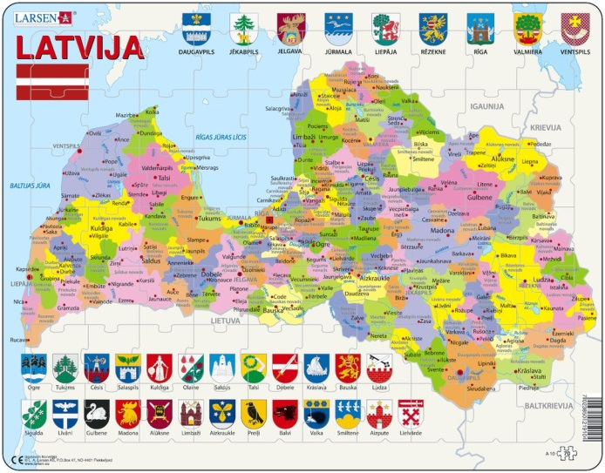
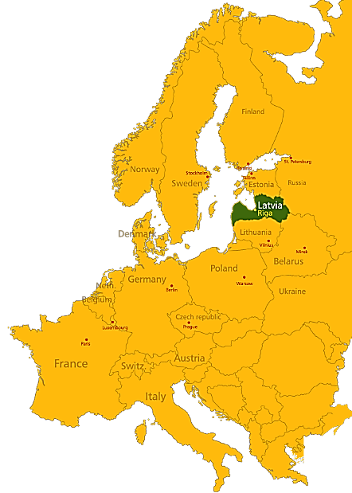
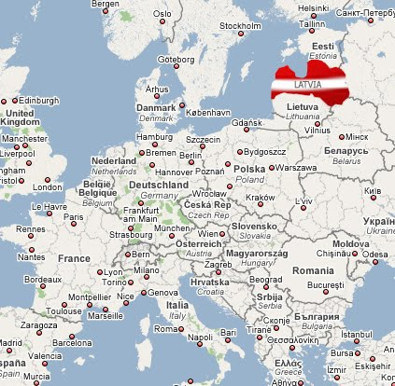
LATVIA
Location: Northern Europe on the East
coast of the Baltic Sea
Area: 64 589 km²
Population: 1,8 million
Population density: 34 people per km²
Capital: Riga (biggest city 0,7 million)
About 68 % of the population live in urban areas
Constitution: Parliamentary Republic
The Unicameral Parliament or Saeima and
Government is elected every four years
Official language: Latvian
International membership:
NATO, EU, UNO, WTO, etc.

Slide 3
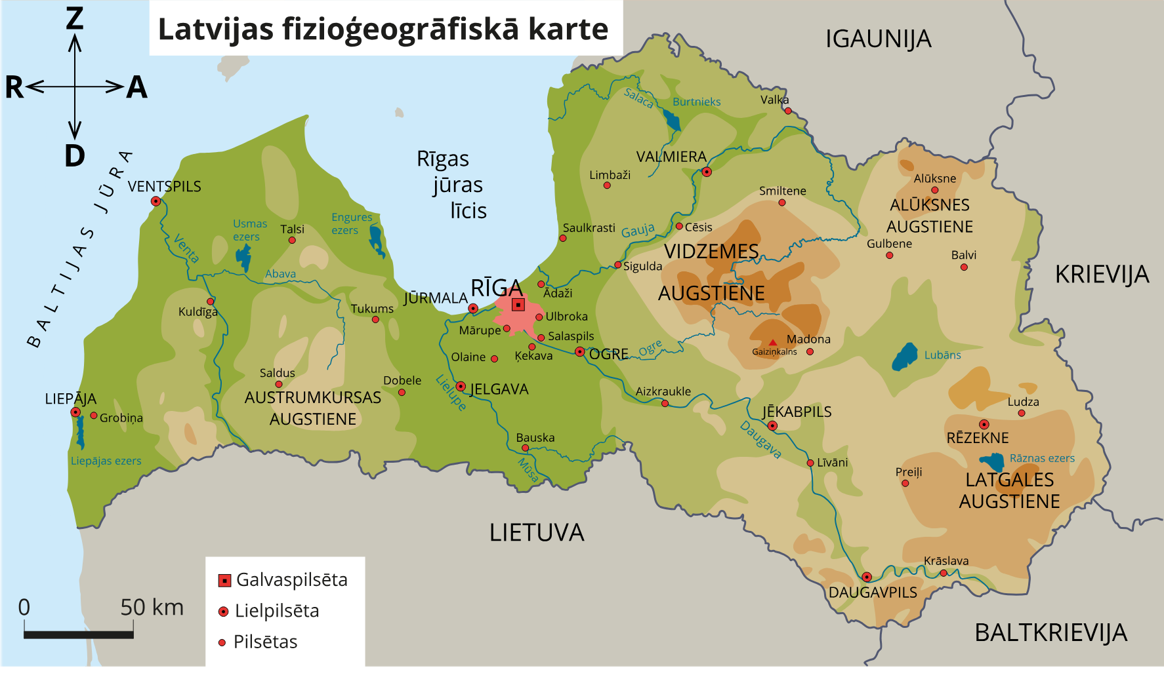
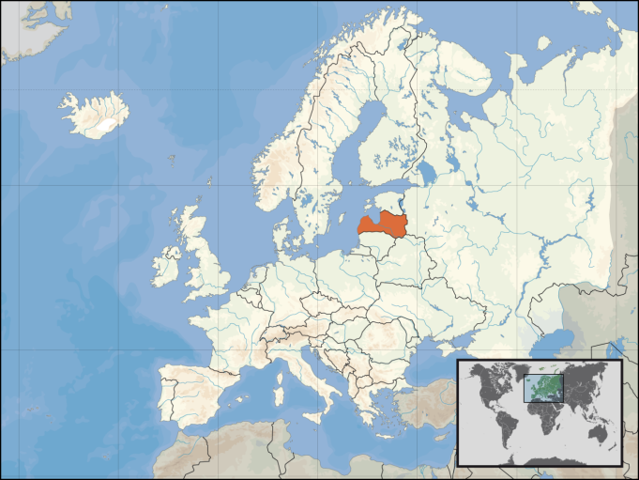
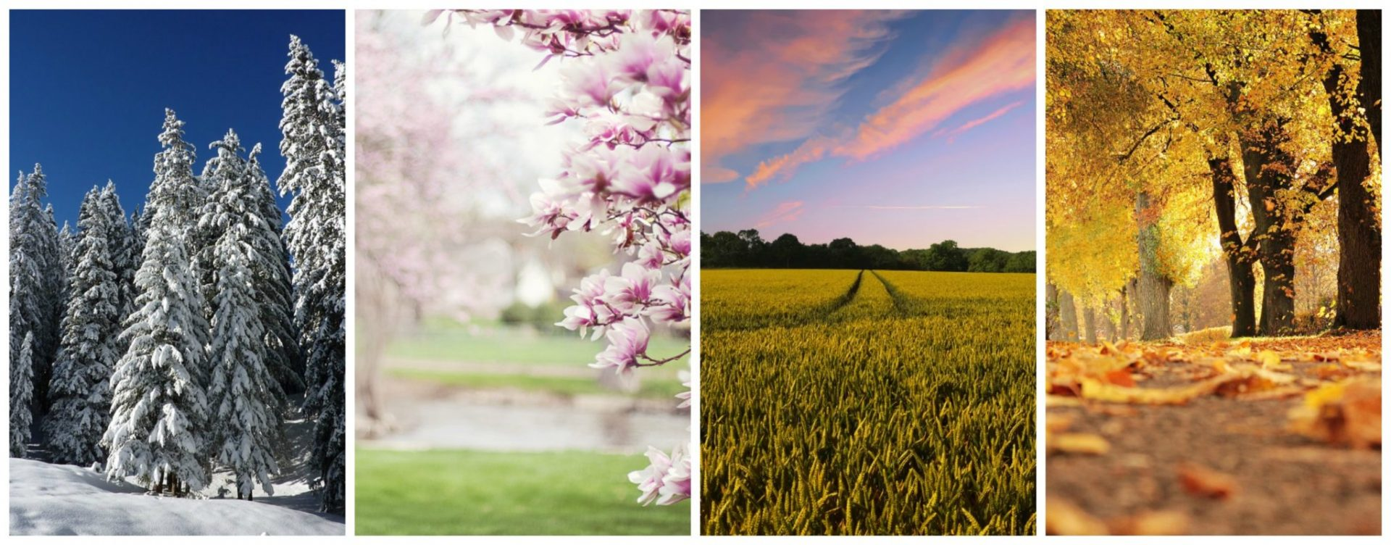
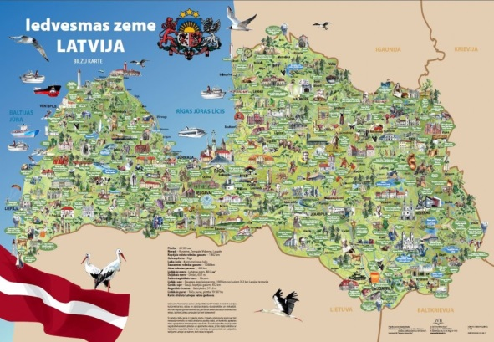
LATVIA’s georgraphy
  51% of the country
  covered by forests
  12 000 rivers
  3000 lakes
  highest point 311m
  500 km Baltic Sea coast

Slide 4

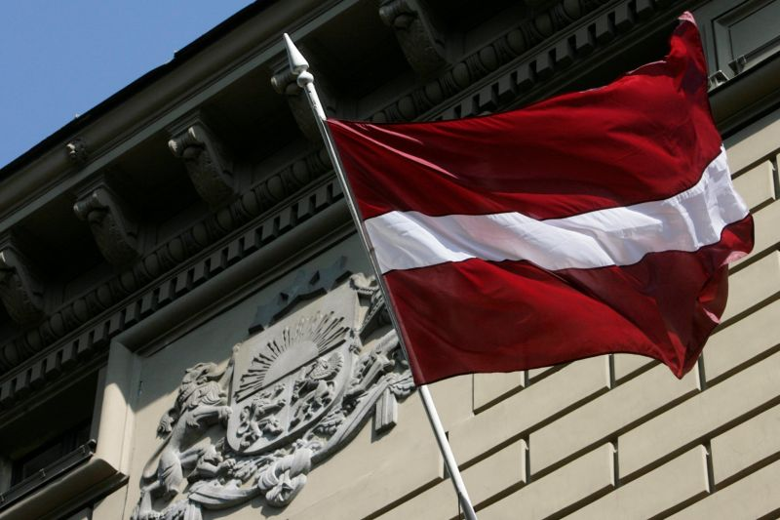
THE FLAG
THE RED-WHITE-RED LATVIAN FLAG IS AMONG THE OLDEST FLAGS IN THE WORLD AND DATES BACK TO THE 13TH CENTURY.
National symbols
THE COAT OF ARMS COMBINES TRADITIONAL HERALDIC SYMBOLS OF LATVIAN NATIONAL IDENTITY WITH THOSE OF HISTORICAL TERITORIAL DISTRICTS.

Slide 5
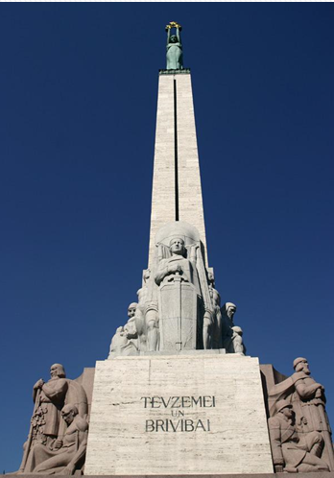
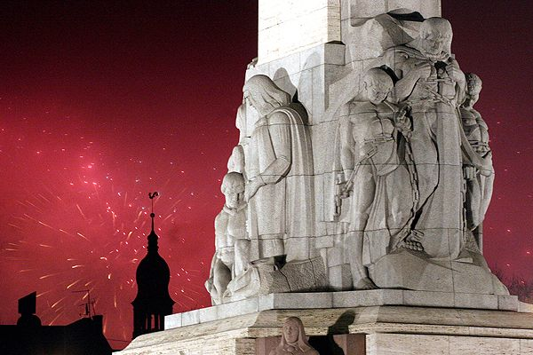
FREEDOM MONUMENT
The symbol of independence –
the Freedom Monument was unveiled on the 18th November, 1935
Designed by a famous Latvian sculptor Kārlis Zāle.
The text written on the monument means “For Fatherland and Freedom!”

Slide 6
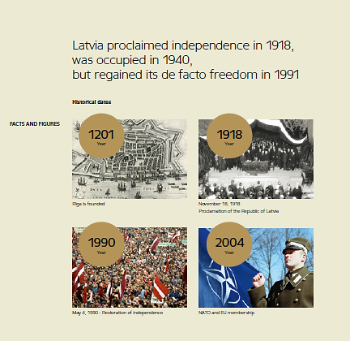
The history of LATVIA

Slide 7
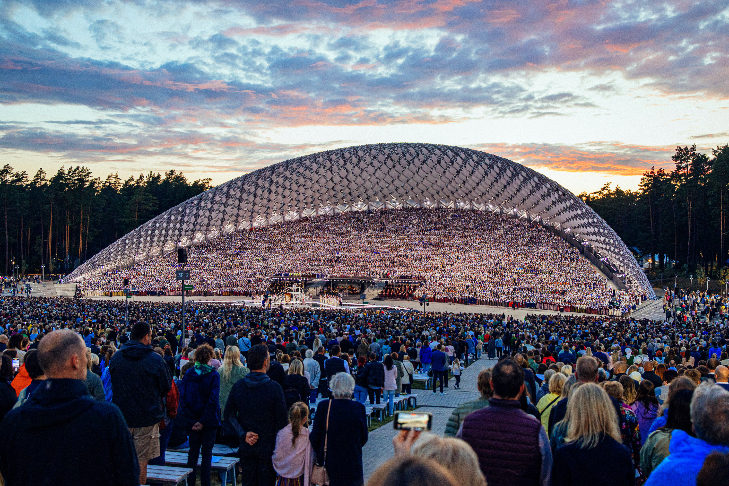
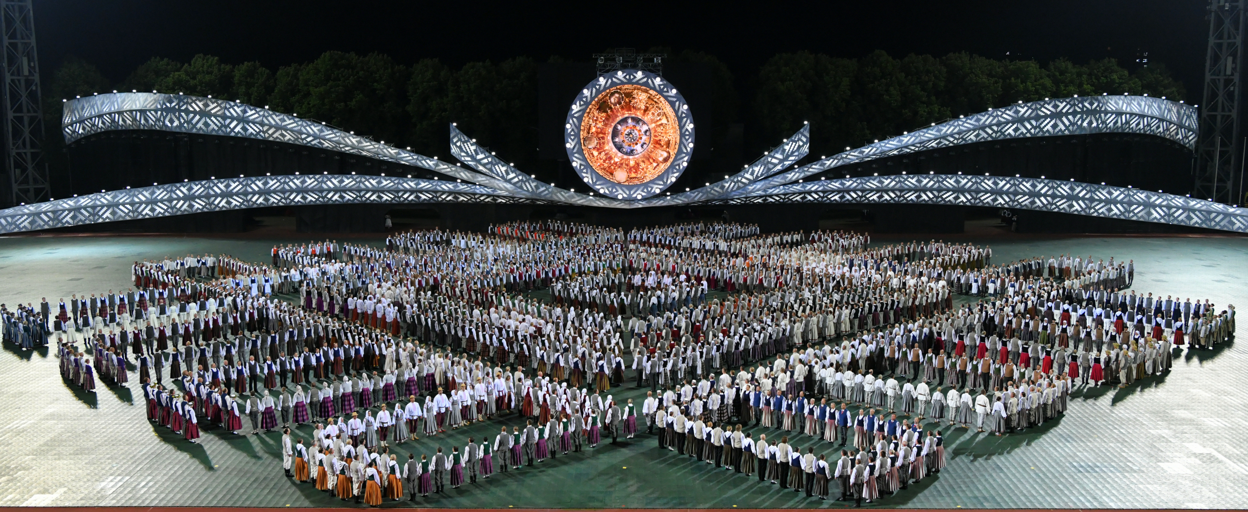
Latvian song and dance festival
ART, MUSIC & TALENT
The first Latvian Song and Dance Festival took place in 1873. Nowadays it is held every four years. UNESCO heritage.
The largest amateur choral events in the world and an important event in Latvian culture and social life.
Approximately 30,000 performers all together participate in the event.

Slide 8
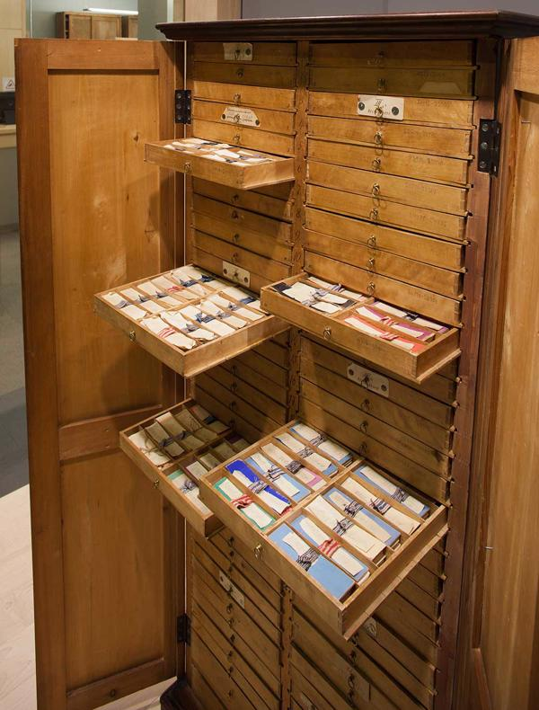
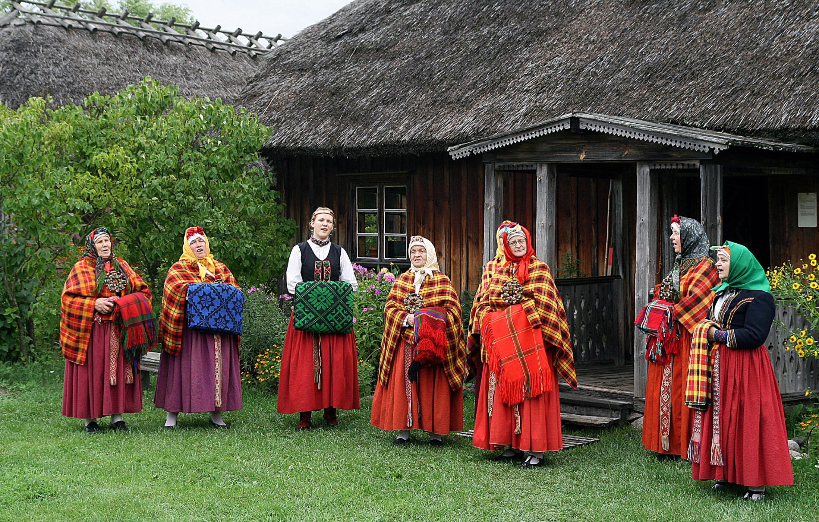
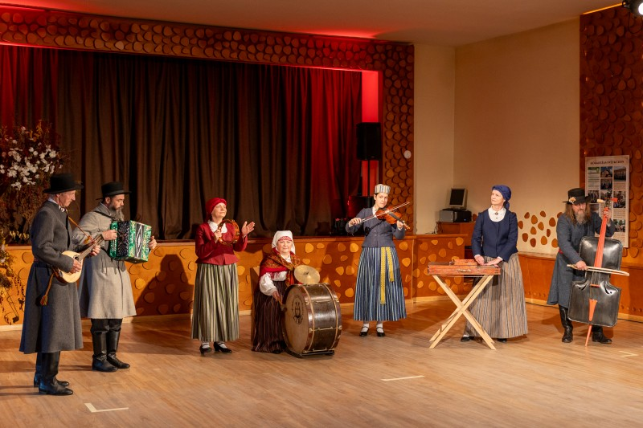
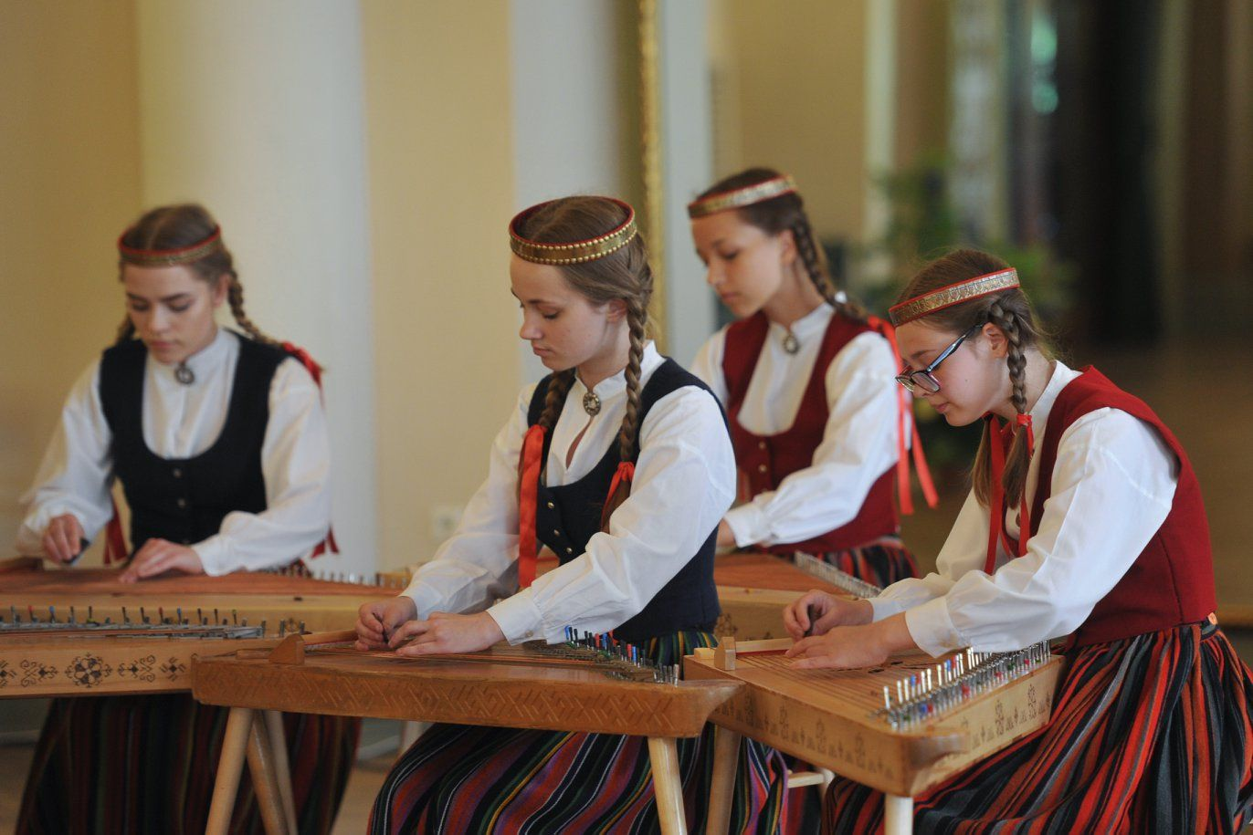
Rich folklore and folk traditions
- The Latvian Cabinet of Folk Songs (Dainu skapis) – one of the largest collections of folk poetry in the world
- The Latvian Ethnographic Open-Air Museum – largest in Europa
- Over 200 folklore ensembles and ethnographic groups

Slide 9
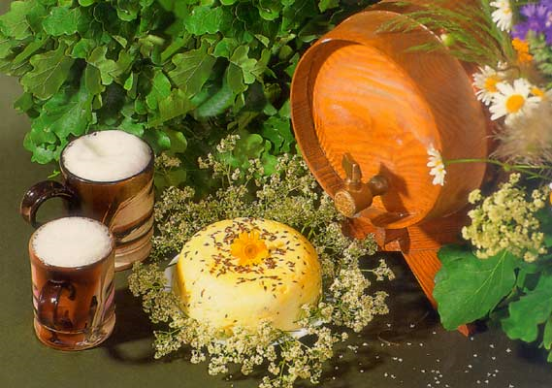
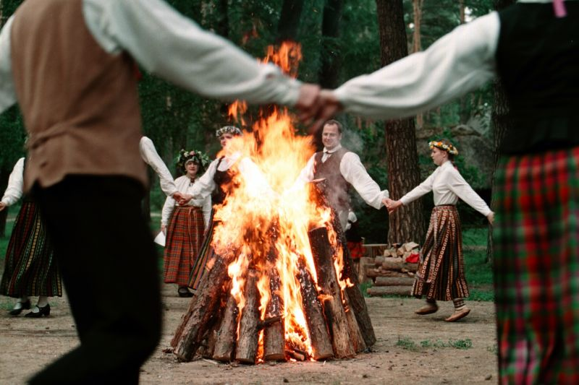
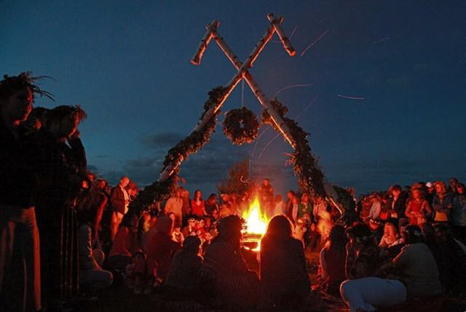
Traditions – Midsummer (LĪGO AND JĀŅI)
Celebration of Summer Solstice (Midsummer) –
the shortest night and the longest day of the year (June 21 to 24).
Typical food is a special cheese with cumin and the most popular drink - beer.
Janis is traditionally the most common male name in Latvia. Everybody of the name Janis holds a special honor on this day.

Slide 10
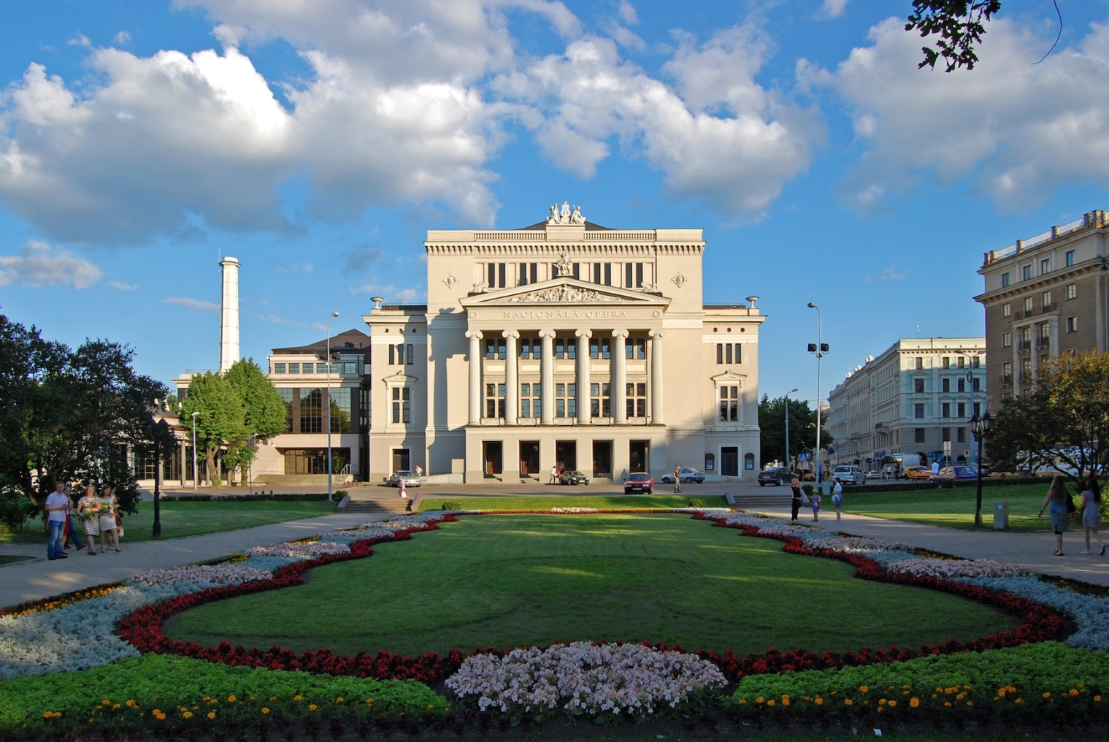
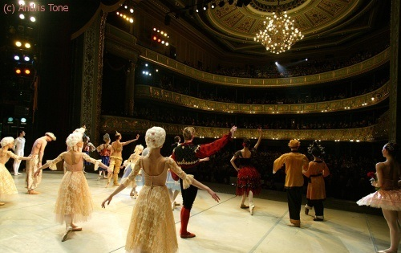
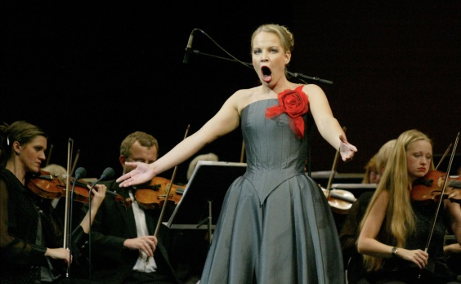
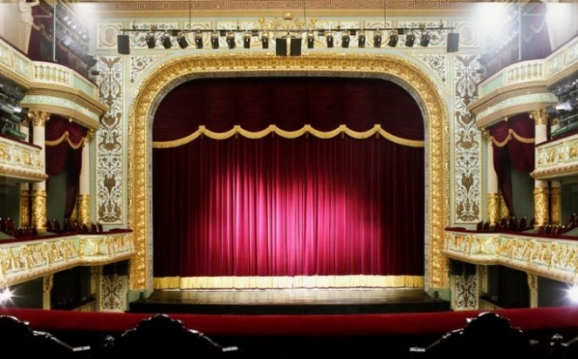
INTERNATIONALLY RECOGNISED
NATIONAL OPERA AND BALLET ENSEMBLES

Slide 11
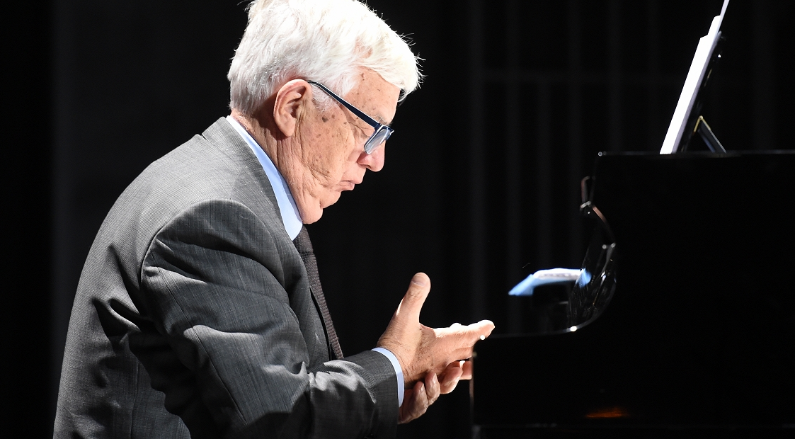
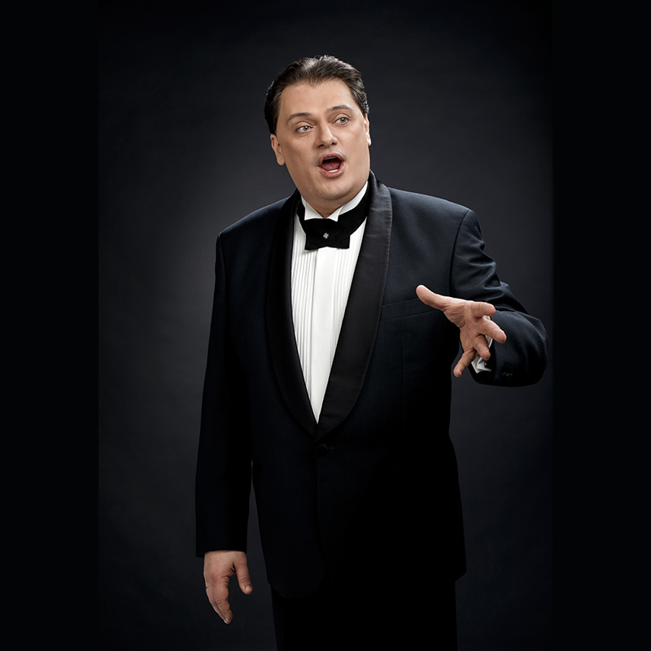
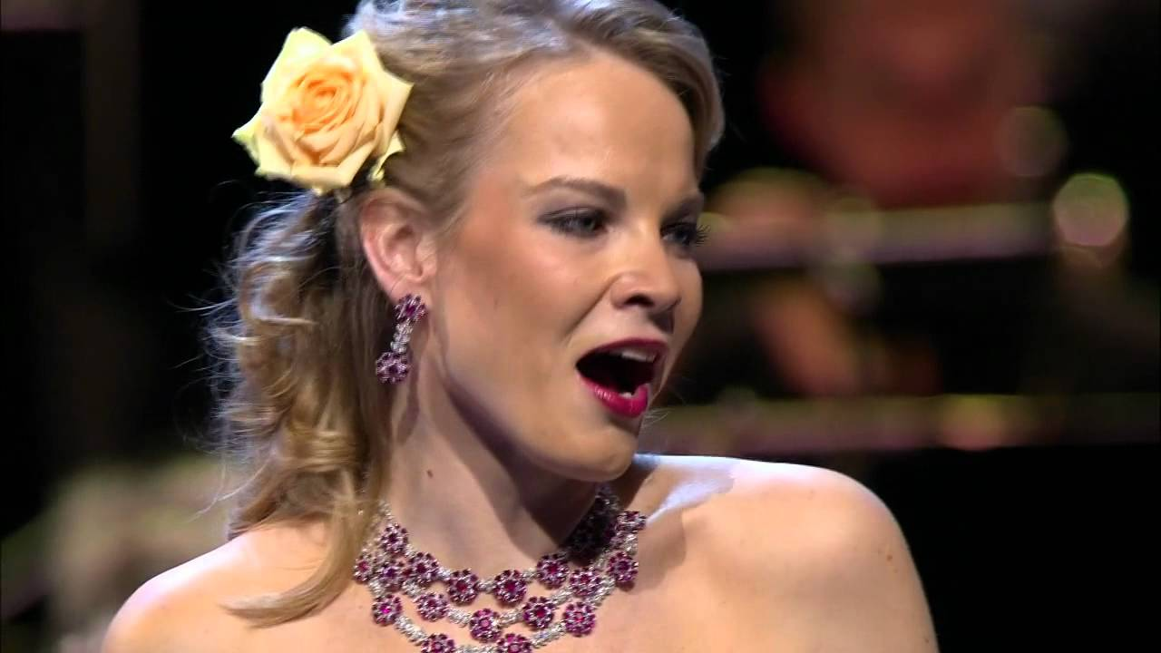
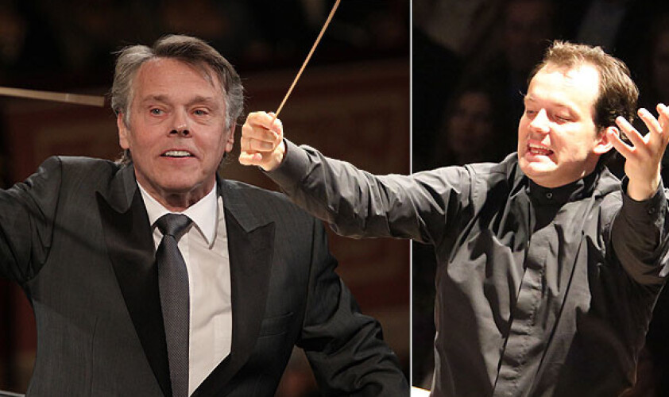
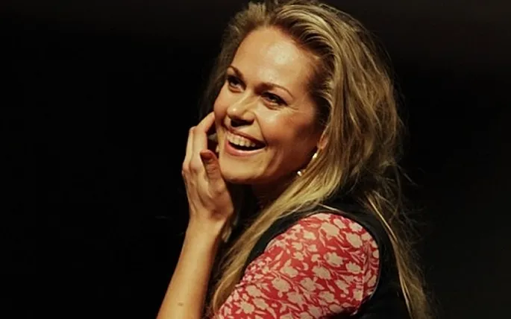
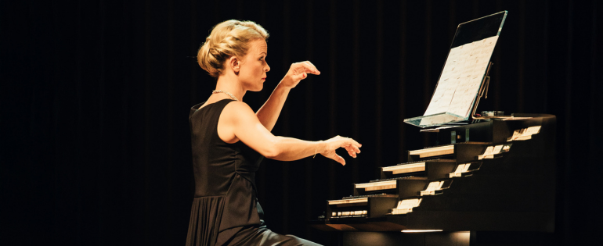
Latvia’s most famous musicians
- Composer Raimonds Pauls
- Tenor Aleksandrs Antoņenko
- Mezzo-Soprano Elīna Garanča
- Conductor Mariss Jansons
- Conductor Andris Nelsons
- Soprano Kristīne Opolais
- Organist Iveta Apkalna

Slide 12
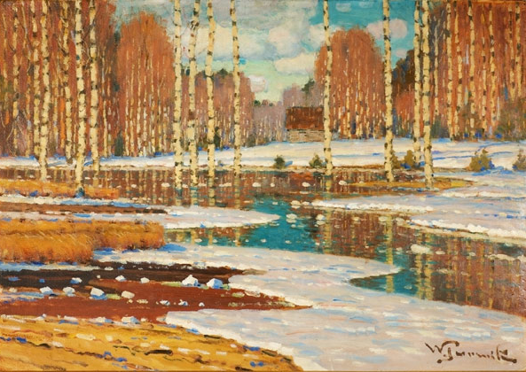

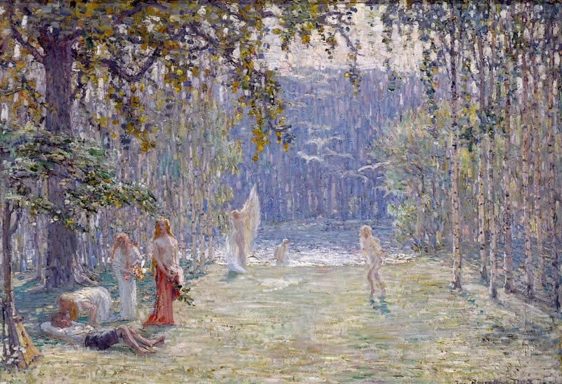
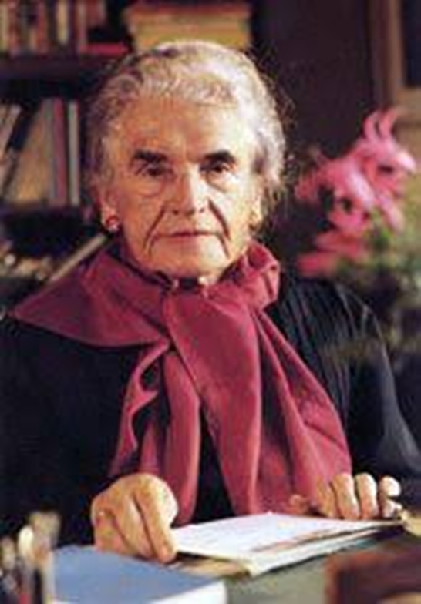
Internationally recognized artists
Vilhelms Purvītis
Jānis Rozentāls
Marko Rotko
Writers of the international range
Rainis
Aspazija
Zenta Mauriņa
Nora Ikstena

Slide 13


Latvia's first-ever Oscar –
«Flow» won best animated feature 2025

Slide 14
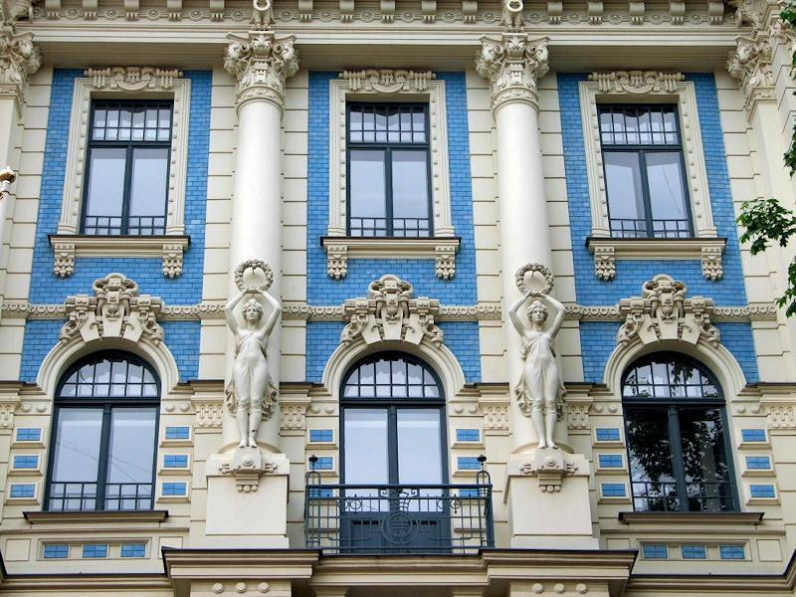
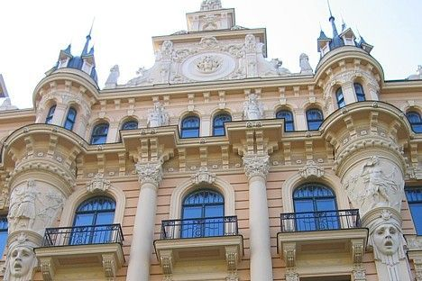
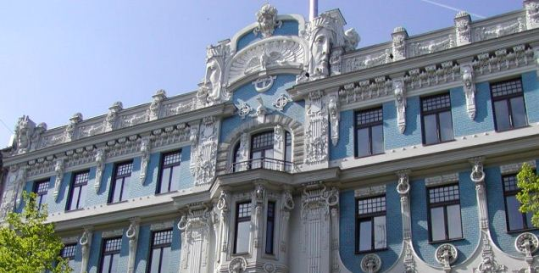
ART NOUVEAU BUILDINGS IN RIGA
Riga is the metropolis of Art Nouveau. This style appeared in late 19th and early 20th century .
One third of the centre of Riga is built in Jugendstil or Art Nouveau style.

Slide 15
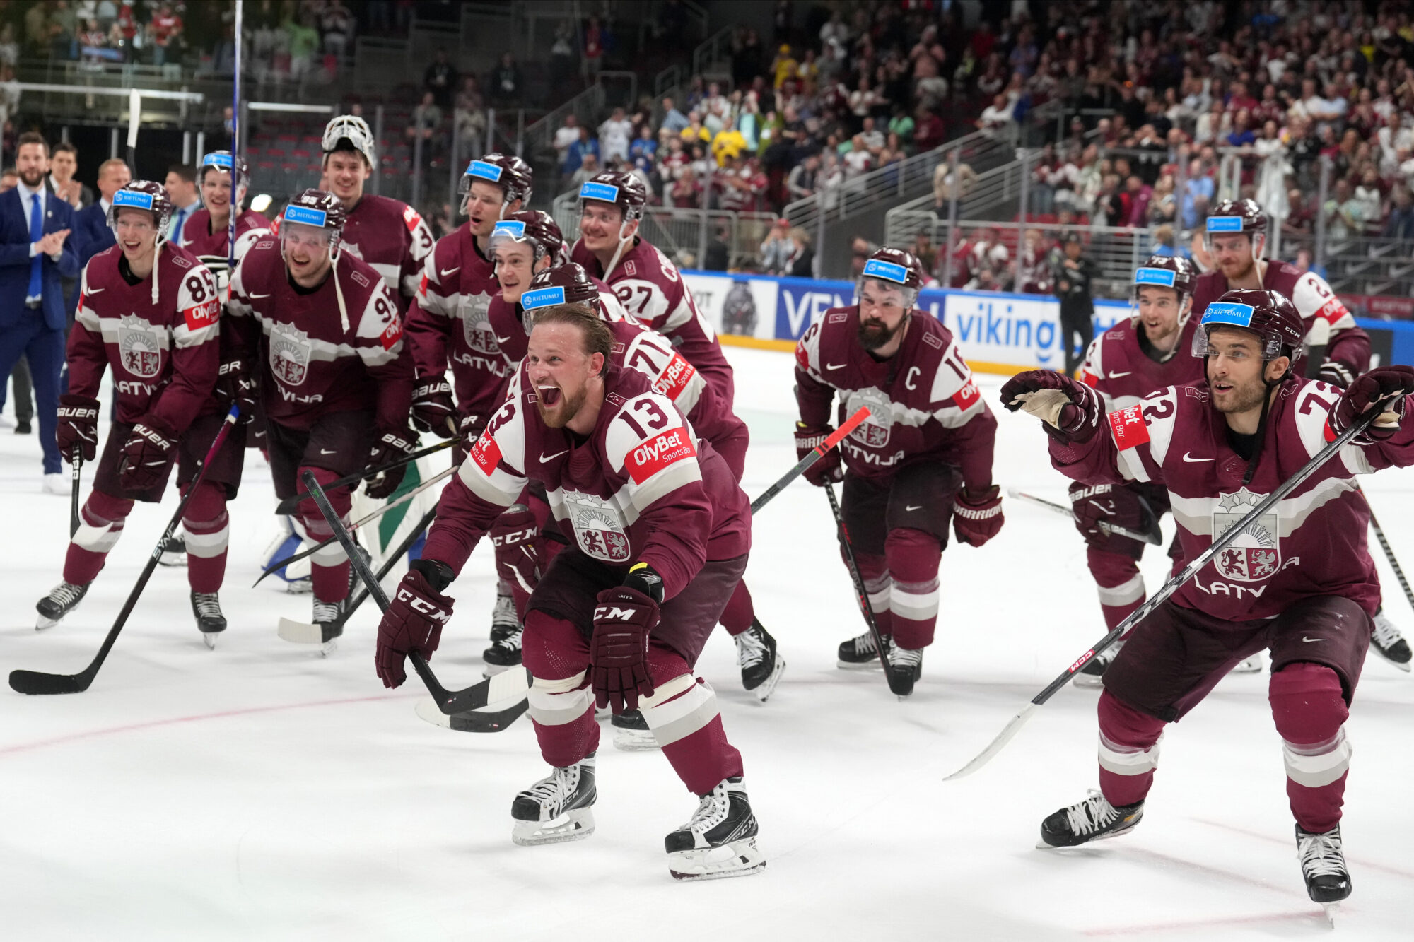
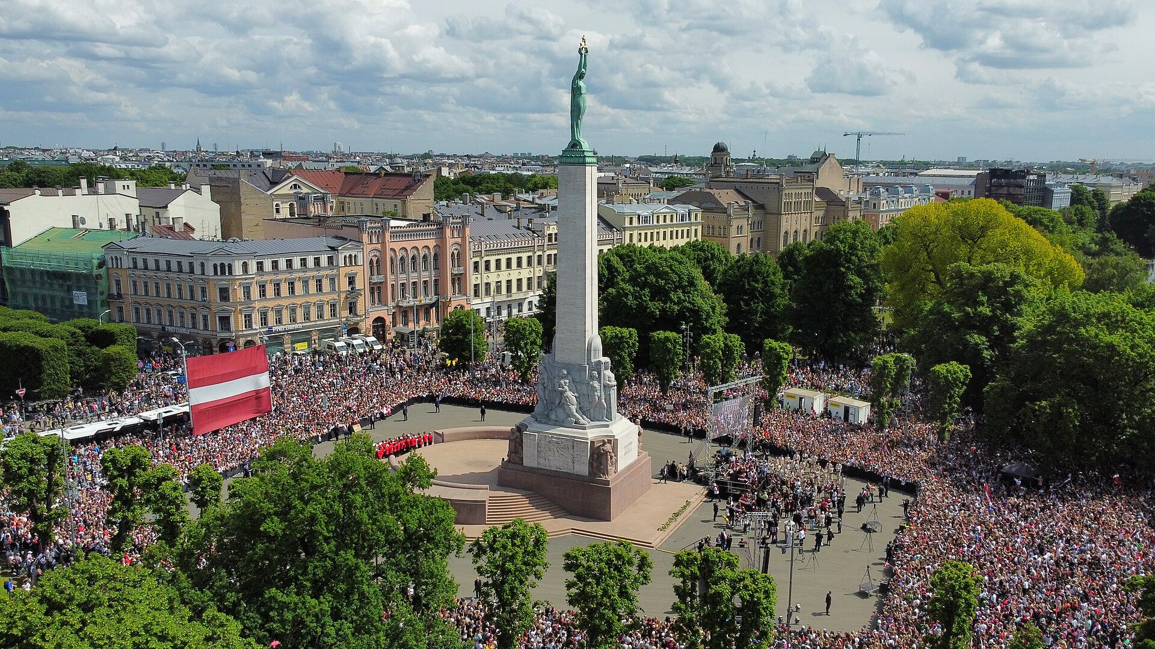
The Latvian national ice hockey team represents Latvia in international ice hockey competitions.
- participated in six Olympic Games — from 1936
- greatest achievement at the World Championships was winning third place in 2023.
- ranked 10th in the International Ice Hockey Federation (IIHF) rankings
SPORTS
World Championship – 2023, 3.place, a nationwide celebration
Ready for the WC in 2026

Slide 16
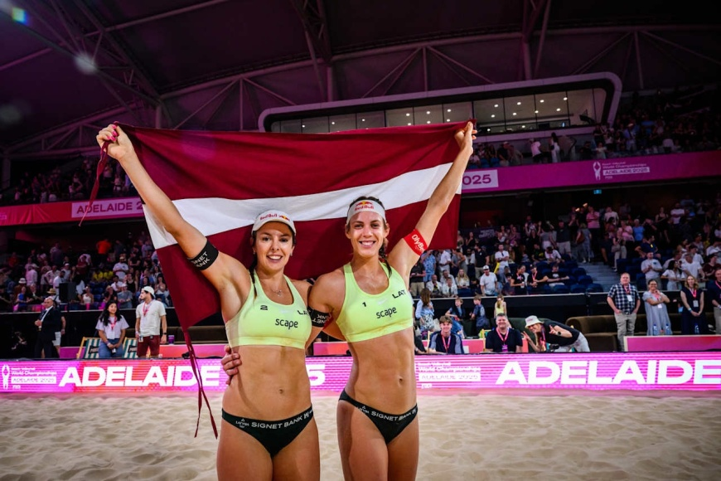
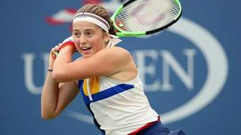
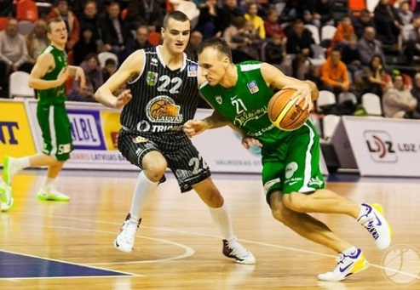
TENNIS
Jelena Ostapenko. Ostapenko has won nine WTA Tour-level singles and twelve doubles titles, including a singles major at the 2017 French Open and a doubles major at the 2024 US Open
BEACH VOLLEYBALL
Mārtiņš Pļaviņš/Jānis Šmēdiņš -Olimpic bronze 2012
Tīna Gaudiņa/Anastasija Samoilova World Beach Volleyball Champion 2025 gold medals in Australia

Slide 17
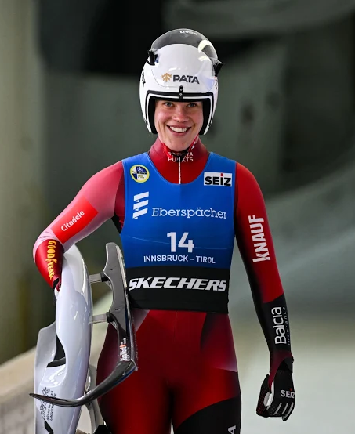
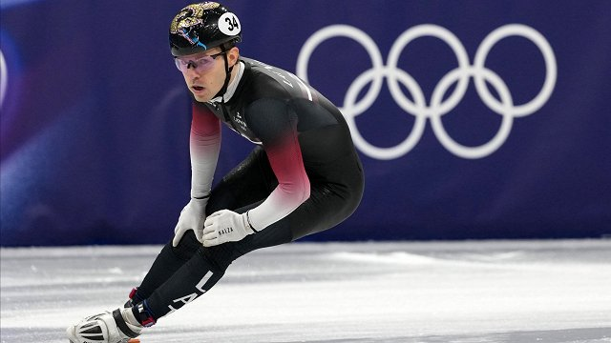
Winter sports Milano-Cortina, 2026 : Latvia
the luge racer Elīna Ieva Bota won a silver medal at the Milan-Cortina Winter Olympic Games in February 2026
Short Track Speed Skating - Roberts Krūsbergs – bronze medal

Slide 18
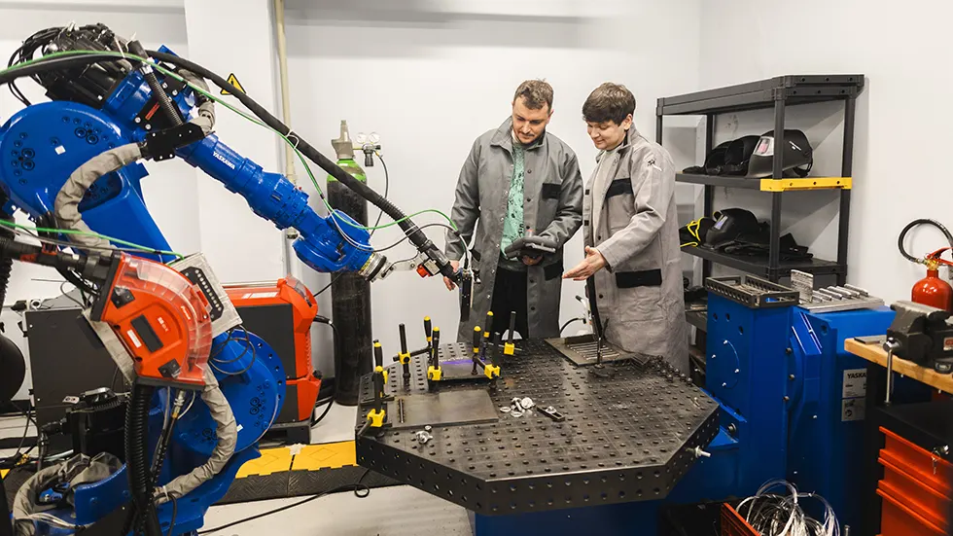
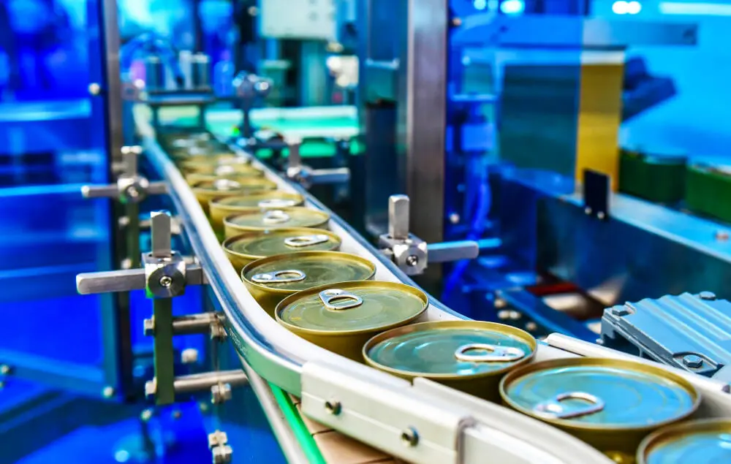
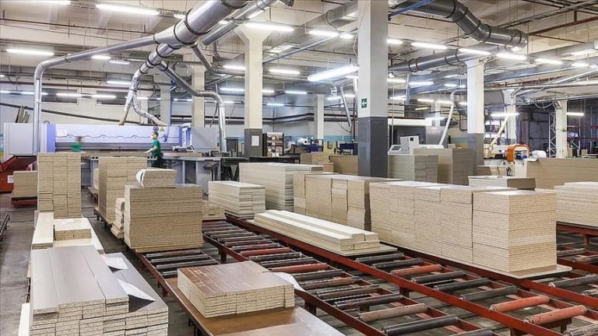

Main industries in Latvia
Wood processing and forestry
Food production
Pharmaceuticals and biotechnology
Engineering and metalworking
IT and digital technologies
Transport and logistics
Growing startup ecosystem

Slide 19
ABOUT US and
OUR ROTARY CLUBS

Slide 20

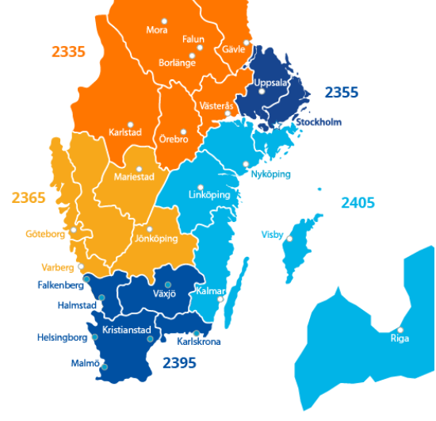
District 2405 - Latvia and south east of Sweden
• Rotary clubs 46 in Sweden, 21 in Latvia
Rotary members 2327 [2025, October]
Goals of the District: PEOPLE-PROJECTS-PUBLICITY
PEOPLE. Active engagement of existing members and recruitment of new members (target: 30% growth)
– Encouraging the recruitment of 2–3 new members annually
– Establishment of 5 new Rotary Clubs
– Establishment of 3 new Rotaract/Interact Clubs
New projects

Slide 21
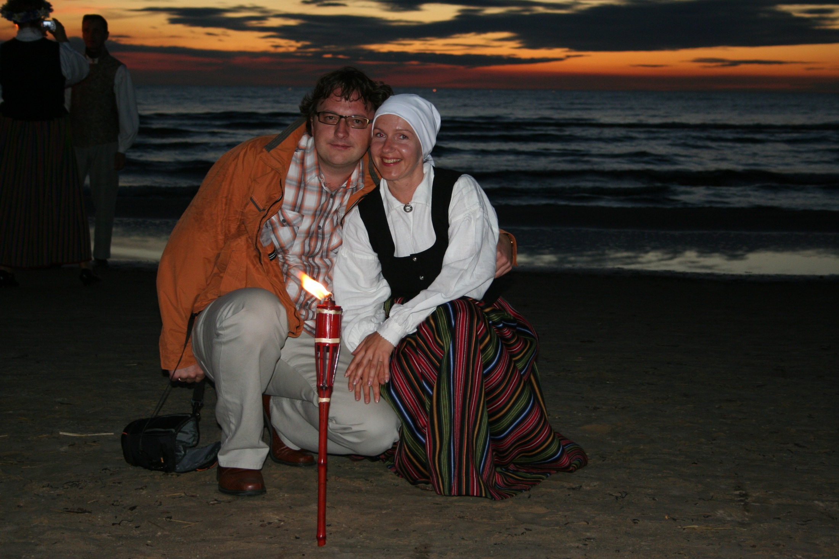
Guntars and Benita, PIERIGAS ROTARY CLUB

Slide 22
Guntars Kniksts un Benita Knikste
Guntars Kniksts
Pierigas RC, District 2410 Governor 2022-2023
Rotarian since 2006, Club president 2008-2009, District RYLA coordinator in Latvia 2011-2016, Asssistant Governor 2016-2022, ICC chair Latvia-Poland, RI President representative at D-3850 Philippines 2024
Education – engineer, MBA degree
Occupation: Regional representative of Latvian investment and development agency
Spending free time playing in a rock band and enjoying live music
Benita Knikste
Education – Bachelor of Business Administration
Occupation – accountant in insurance company
Enjoy folk dancing and traditional Latvian sauna

Slide 23
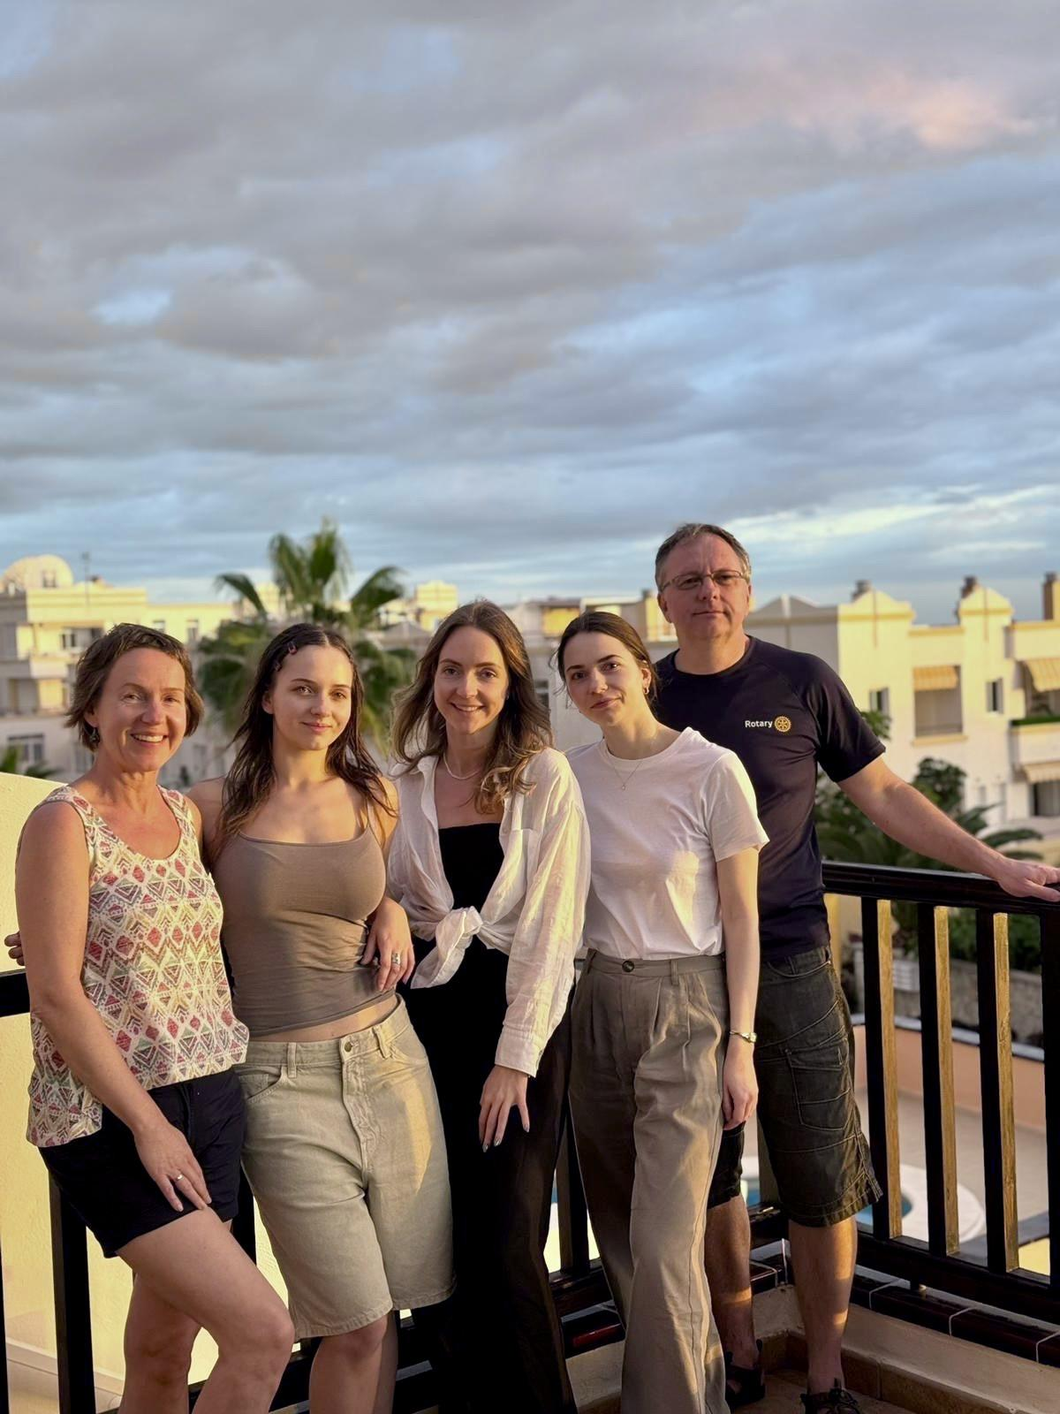
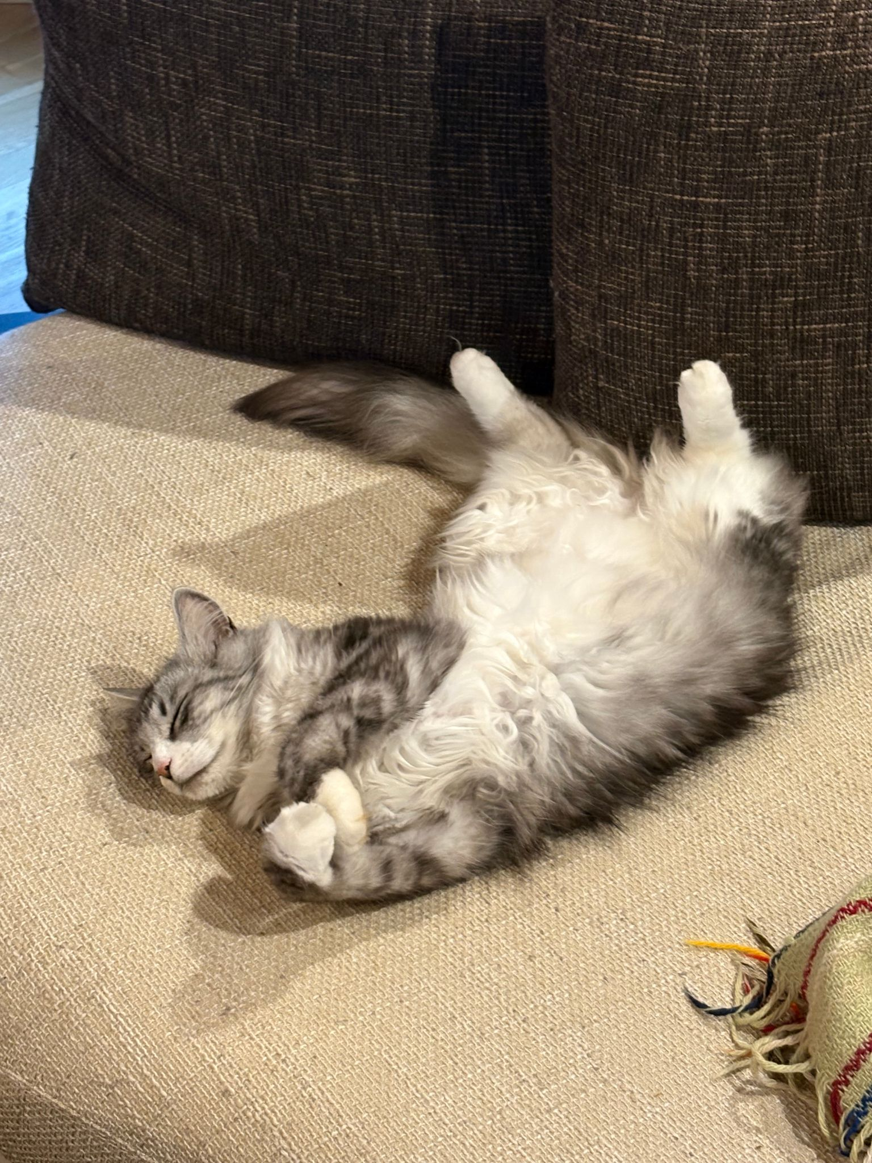


Guntars and Benita’s family

Slide 24



Guntars Kniksts, District Governor 2022-23

Slide 25


MAIJA LINE
Rotary Club of Riga Ridzene
-Member of the Club since 1996 (charter member)
-President of the Club 2003-2004
-Board member 2005-2020
-D 2410 GSE co-ordinator in Latvia 1999-2009
-Assistant Governor 2008-2011
-D 2410 RFE Chairperson 2012-2026
-GSE team leader
to Australia 2006

Slide 26

MAIJA LINE
Education – philologist, teacher, translator
Graduated from the University of Latvia, Department of English studies.
Occupation – now retired.
Last 21 year worked in the Ministry of Culture of Latvia
Family - have a daughter and a son, and five grandchildren.
Interests. Enjoy travelling, attending art and music events, walking on the
beach and picking wild berries and mushrooms in the forest.

Slide 27


ROTARY CLUB OF RIGA RIDZENE
Founded in 1996
Club during last decade has realised great number of charity projects
-Organized a social rehabilitation camp Angel Camp for children with untreatable diseases and families
-During Covid pandemic rendered support to doctors, who were fighting disease 24 hours.
-Help to Ukraine – started in 2015 with grand project War Children. Since 2022 Club helps by donating things for Ukrainean people, warm underwear for soldiers, things for babies in Kyiv Maturity hospital, etc.
-Help to disadvantaged street children – club donated for furnishing appartment, where they can find safe place.
-Support to Riga Active Senior association’s choir – donated
digital piano.
-Support to the young BMX team – donated shelter tent.
Riga Ridzene organized Rotary Summer Get-together 2025

Slide 28

Ludmila Jansone
Rotary Club of Riga Ridzene
Rotarian since1997
GSE leader year 2010
President of Riga Ridzene Rotary
club, year 2010-2011
Project manager 2015-2026
Education-economy,finances
Retired

Slide 29

Rotary club of Riga Ridzene visiting Ventspils

Slide 30

Jānis Verlis, Riga Rotary Club
Jānis Verlis is a member of Riga Rotary club, the oldest club in Latvia, founded in 1933, renewed in 1993, member of the club 18 years, was its president in 2012-2013.
Jānis is engaged in the timber business, has one daughter and one son, and six grandchildren.
Hobbies include swimming, opera, and theatre.

Slide 31





Riga Rotary club projects 2015-2026
Laza and equip special boarding school
Internat cabinets, kitchen tables and chairs, washing machine, 60 chairs Aula
The school's playground, 15 computers, 2 sewing machines, furniture
Ciblas school - school bags
Riga Disabled Society - Christmas gifts
Riga Children's Hospital
A charity concert «War Children»
Mobile lifting device for the nursing station Vegi

Slide 32

Dans Čiščakovs
Valmiera Rotary club

Slide 33

Valmiera Rotary club

Slide 34

Jānis Akerfelds Liepājas Rotary club

Slide 35

Jānis Akerfelds and Guna Akerfelde
Member of club since 2022
Wife Guna, 2 children son 12 years and daughter 9 years
Company owner – Modular house production– Module house export to 6 European countries.
Company since 2004.
Development – Real estate developer Hobbies – beach tennis

Slide 36


Slide 37

Maija Kūle,
Riga Hansa Rotary club,
Rihards Kūlis
Philosophy, both are professors, University of Latvia, Maija is a Riga Hansa Rotary club member from 1996 and Paul Haris certificate of recognition and Paul Harris Fellow medallion.
2 sons Matiss and Maris, 6 grandchildren. Hobby – Maija: reading, writing philosophical essays, travel, Rihards: history of philosophy, music, gardening

Slide 38


Slide 39


Thank you for the attention!
Paldies par uzmanību!

