Slide 1

Rotary Friendship exchange
D2405 Latvia/Sweden –D4945 Argentina/Uruguay
2026, April 16 – 26.

Slide 2

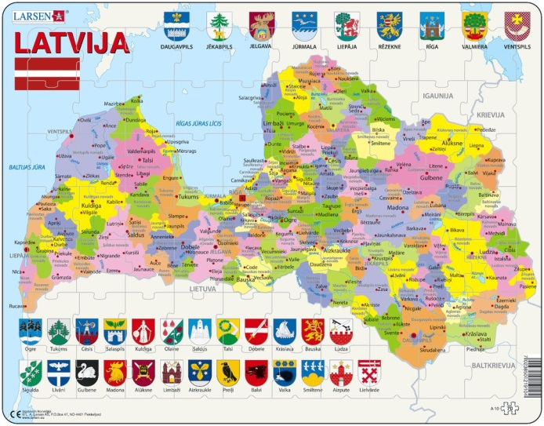
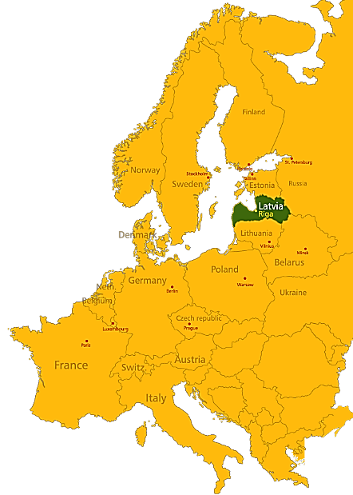
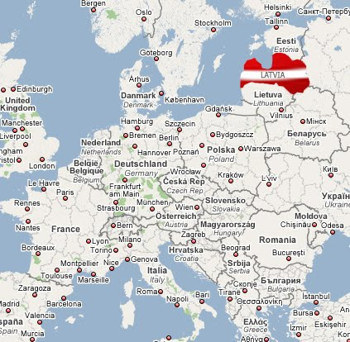
LATVIA
Located in the Northern Europe on the East
coast of the Baltic Sea
Central country of the Baltic States between
Estonia and Lithuania
Area: 64 589 km²
Population: 1,8 million
Population density: 34 people per km²
Capital: Riga (biggest city 0,7 million)
About 68 % of the population live in urban areas
Constitution: Parliamentary Republic
The Unicameral Parliament or Saeima and
Government is elected every four years
Official State Language: Latvian
International membership: NATO, EU, UNO, WTO, etc.

Slide 3

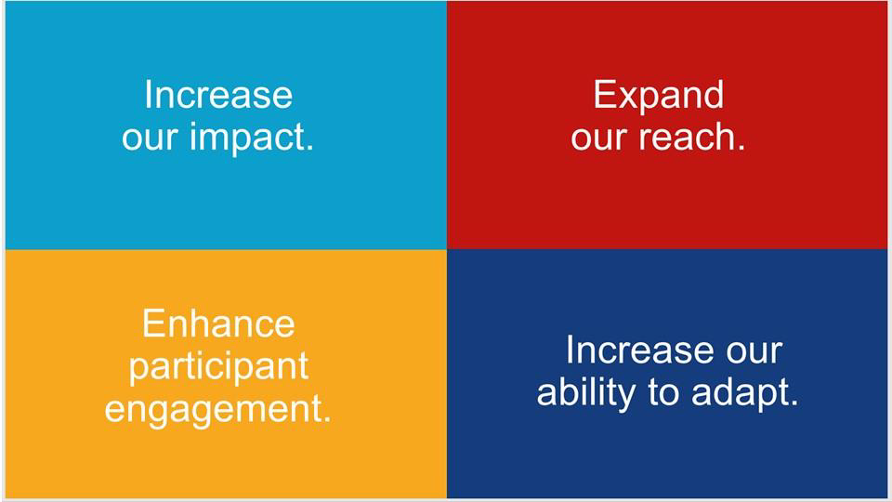
District 2405
Rotary clubs in Latvia and Sweden
• Rotary clubs 46 – in Sweden 21 – in Latvia
Rotary members 2327 [2025, October]
Goals of the District PEOPLE-PROJECTS-PUBLICITY
Rotary international action plan
PEOPLE. Active engagement of existing members and recruitment of new members (target: 30% growth)
– Encouraging the recruitment of 2–3 new members annually
– Establishment of 5 new Rotary Clubs
– Establishment of 3 new Rotaract/Interact ClubsNew projects

Slide 4

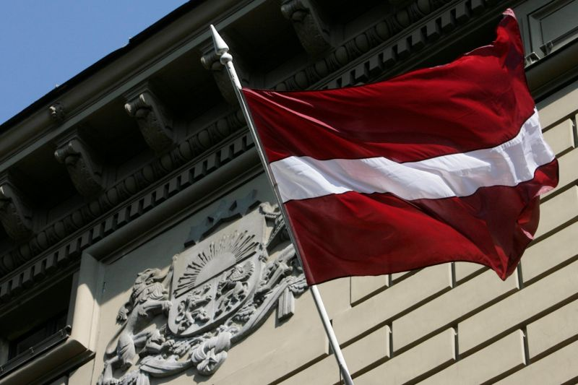
THE FLAG
THE RED-WHITE-RED LATVIAN FLAG IS AMONG THE OLDEST FLAGS IN THE WORLD AND DATES BACK TO THE 13TH CENTURY.
THE COAT OF ARMS COMBINES TRADITIONAL HERALDIC SYMBOLS OF LATVIAN NATIONAL IDENTITY WITH THOSE OF HISTORICAL TERITORIAL DISTRICTS.

Slide 5
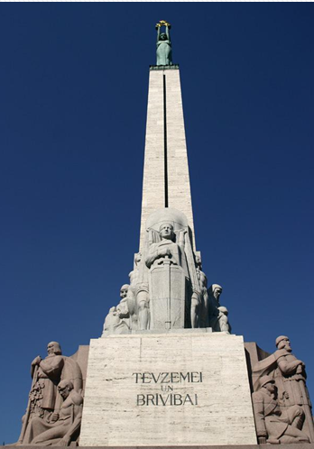
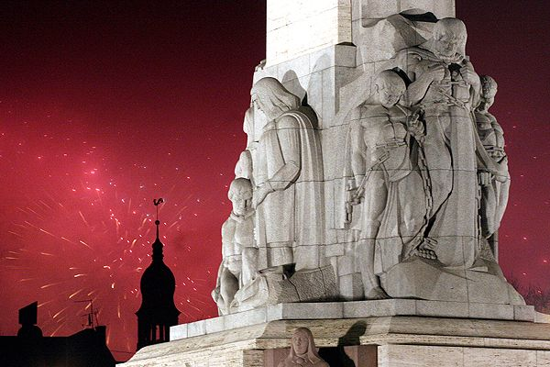
FREEDOM MONUMENT
The symbol of independence –
the Freedom Monument was unveiled on the 18th November, 1935
Designed by a famous Latvian sculptor Kārlis Zāle.
The text written on the monument means “For Fatherland and Freedom!”

Slide 6
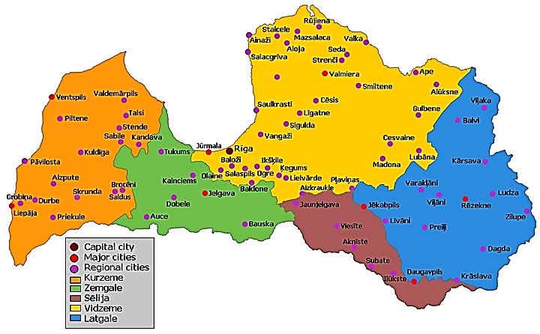
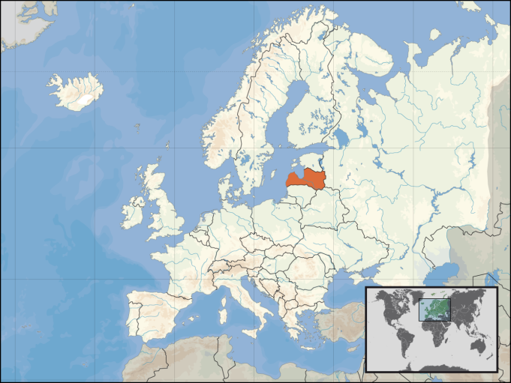
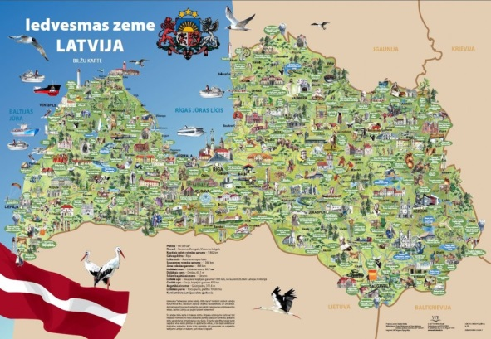
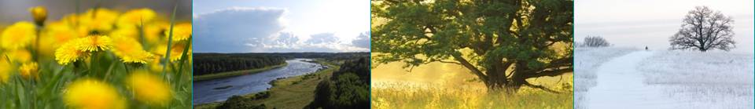
LATVIA: GENERAL FACTS
GEOGRAPHY:
  51% of the country
  covered by forests
  12 000 rivers
  3000 lakes
  highest point 311m
  500 km Baltic Sea coast

Slide 7
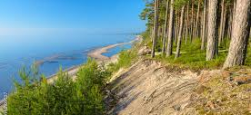
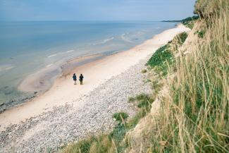
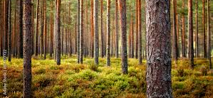
Natural resources: water, timber, sand, gravel, dolomite, limestone, peat, clay, rich biodiversity

Slide 8
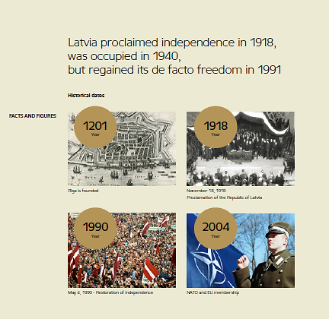
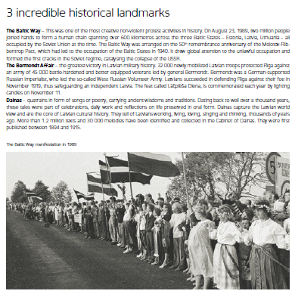
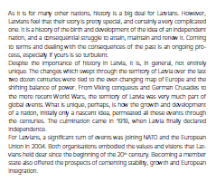
LATVIAN HISTORY

Slide 9
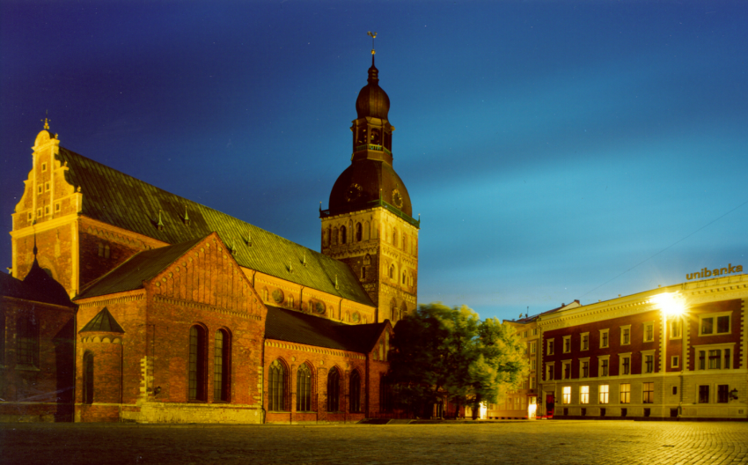

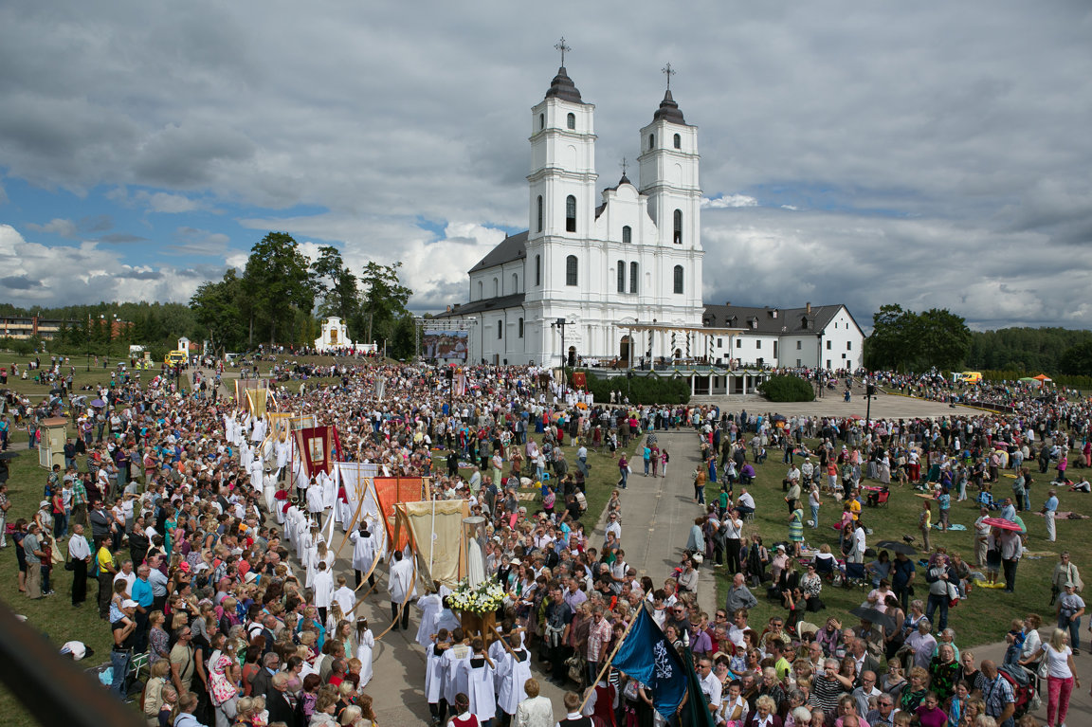
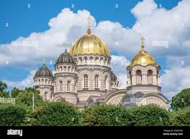
Religions in Latvia:
Evangelic Lutheran,
Roman Catholic,
Russian Ortodox
Popes visited Riga and Aglona – John Paul II, 1993, pope Fransiskus- 2018
Organ in the Riga Dome Cathedral (19 cent.) – one of the biggest in Europe
New religious movements, New Age, sects

Slide 10
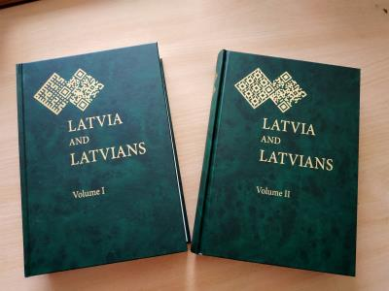
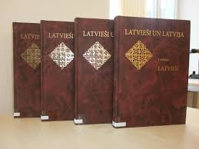
The newest academic writtings on Latvia and Latvians,
2018, vol. 1-2
Latvians and Latvia, vol. 1-4, 2014
2018, Latvian Academy of sciences
2014, LAS
https://dom.lndb.lv/data/obj/file/27456263.pdf
https://dom.lndb.lv/data/obj/771521.html

Slide 11
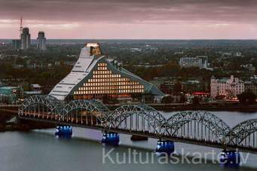
  MORE THAN 2000 LIBRARIES IN LATVIA
  and NEW NATIONAL LIBRARY IN RIGA

Slide 12
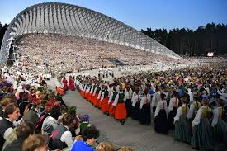
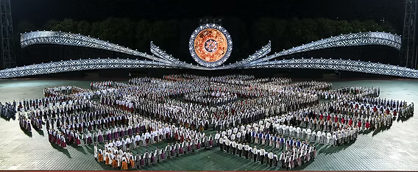
LATVIAN SONG AND DANCE
FESTIVAL
The first Latvian Song and Dance Festival took place in 1873. Nowadays it is held every four years.
It is one of the largest amateur choral events in the world and an important event in Latvian culture and social life.
Approximately 30,000 performers all together participate in the event.

Slide 13
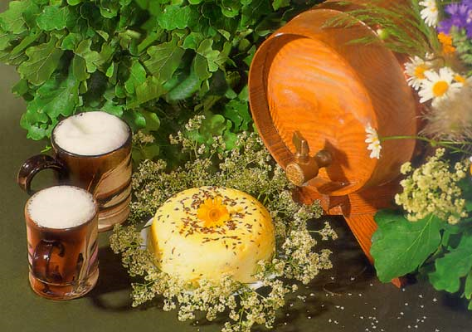
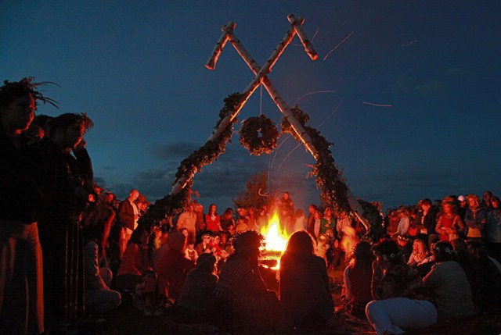
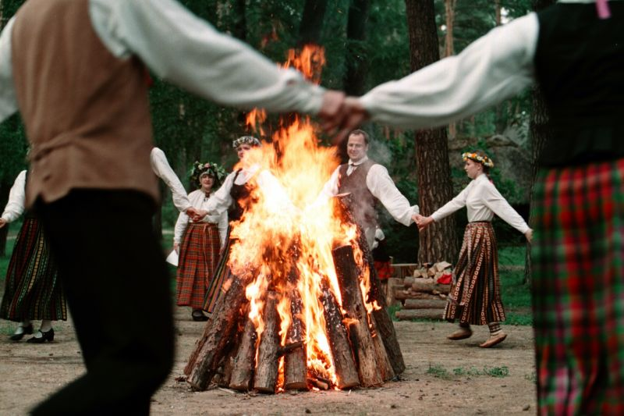
LĪGO AND JĀŅI
It is a celebration of Summer Solstice (Midsummer) –
the shortest night and the longest day of the year (June 23 to 24).
Typical food is a special cheese with cumin and the most popular drink - beer.
Janis is traditionally the most common male name in Latvia. Everybody of the name Janis holds a special honor on this day

Slide 14
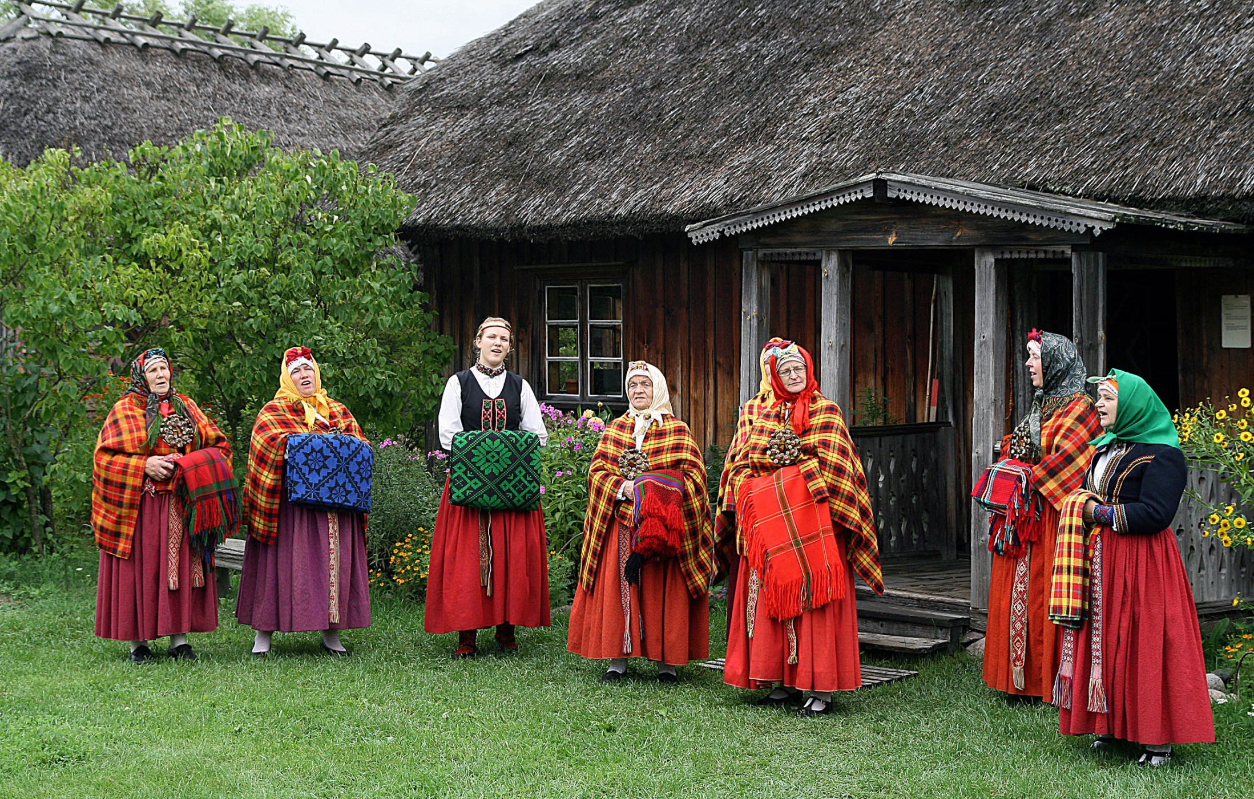
THE MOST VISITED MUSEUM IN LATVIA –
THE ETHNOGRAPHIC OPEN-AIR MUSEUM

Slide 15
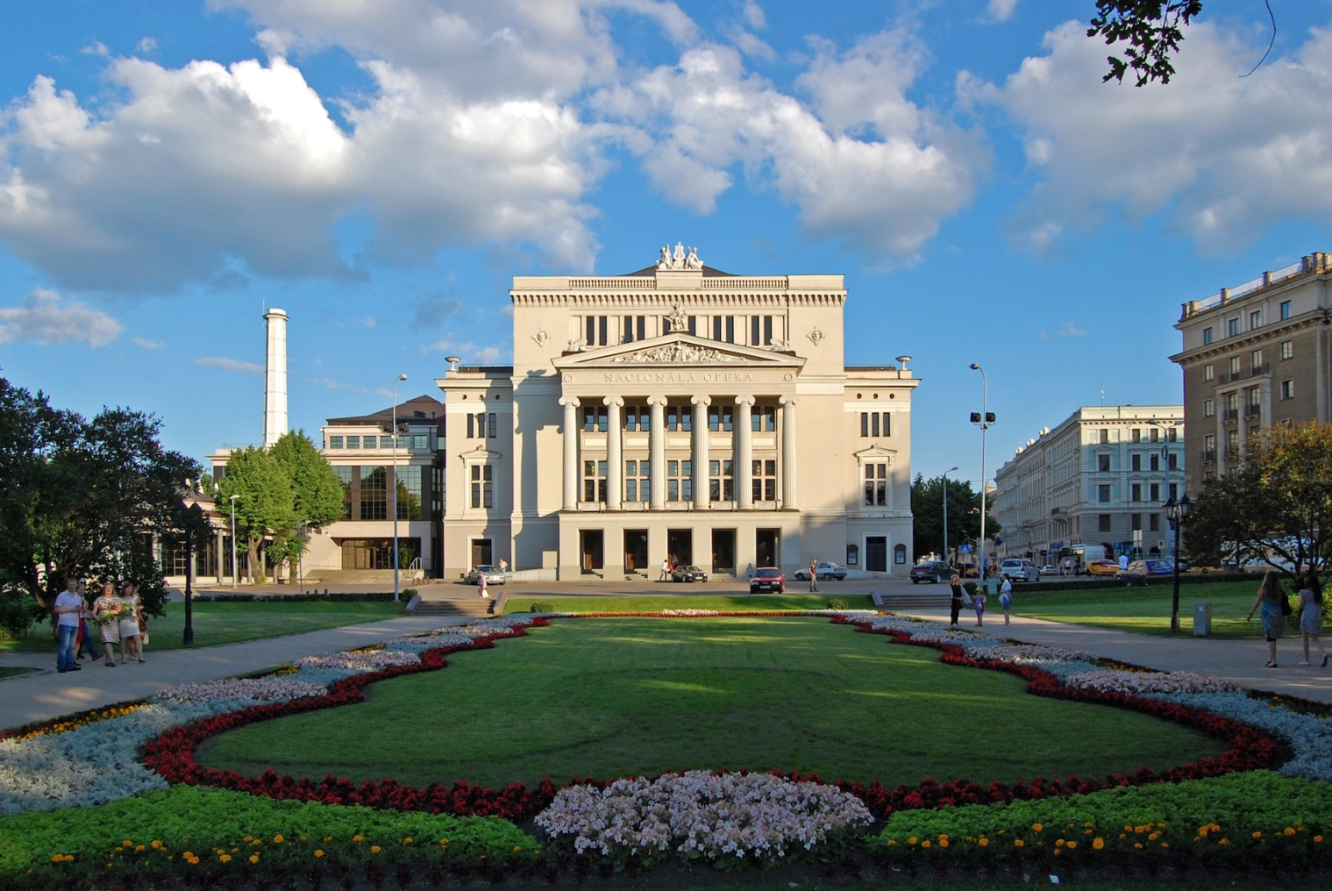
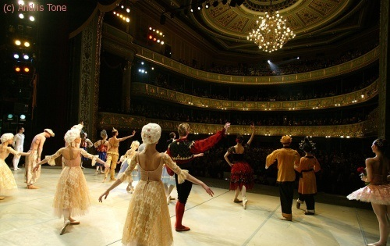
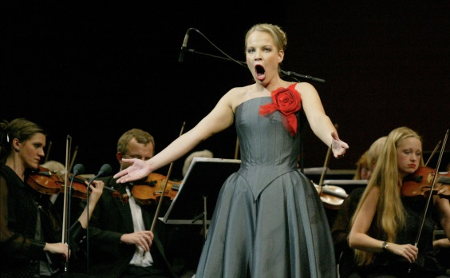
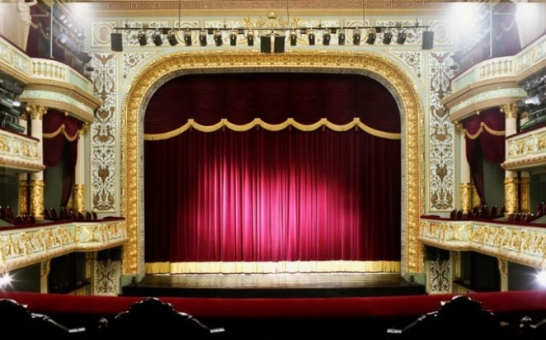
INTERNATIONALLY RECOGNISED
NATIONAL OPERA AND BALLET ENSEMBLES
  WORLD FAMOUS OPERA SOLISTS RISE FROM LATVIA: ELĪNA GARANČA

Slide 16
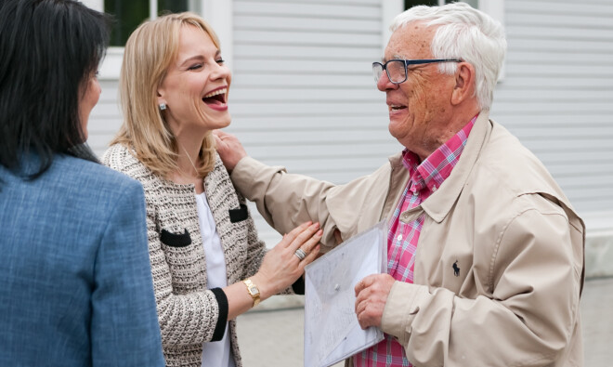
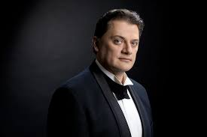
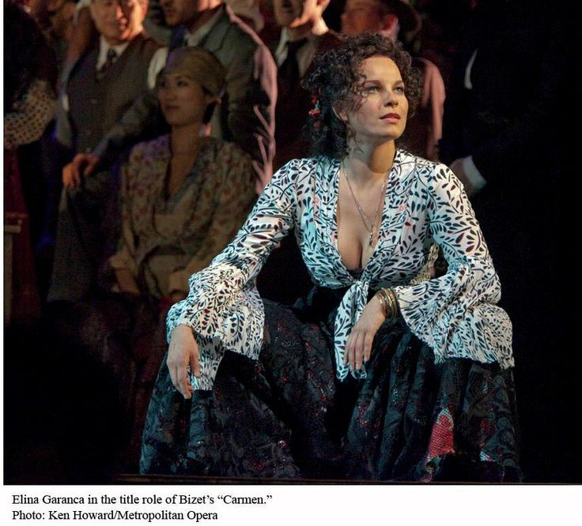
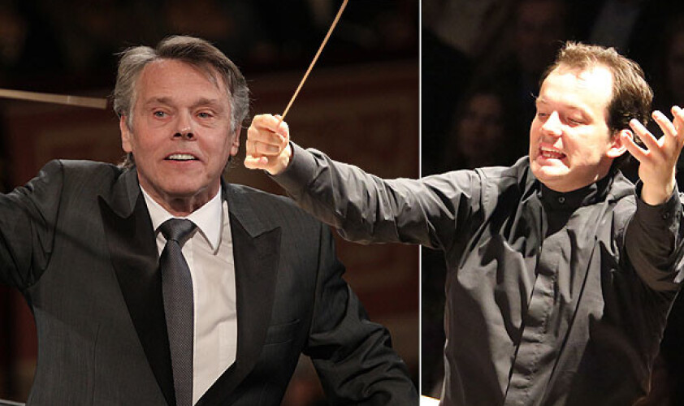
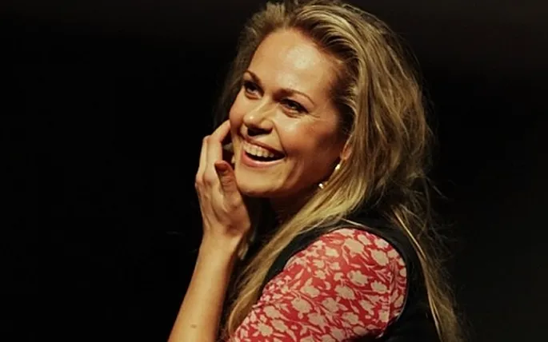
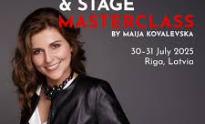
Latvia’s most famous musicians
Composer Raimonds Pauls and mezzo-soprano Elīna Garanča
2. Tenor Aleksandrs Antoņenko
3. Elīna Garanča as Karmen
4. Conductor Mariss Jansons
5. Conductor Andris Nelsons
6. Soprano Kristīne Opolais
7. Soprano Maija Kovaļevska

Slide 17



Slide 18
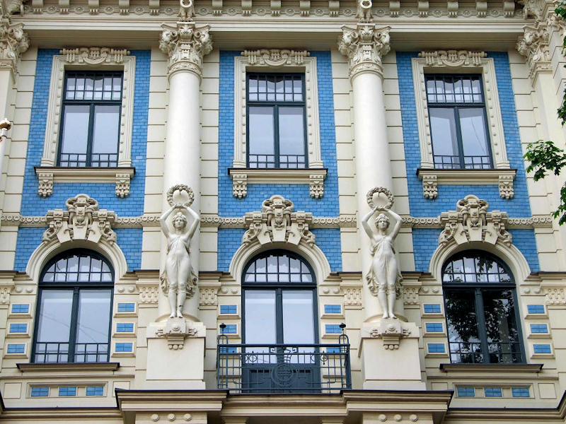
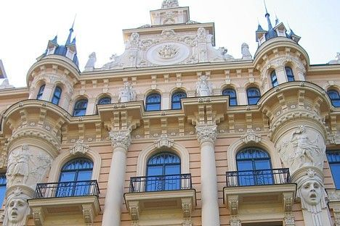
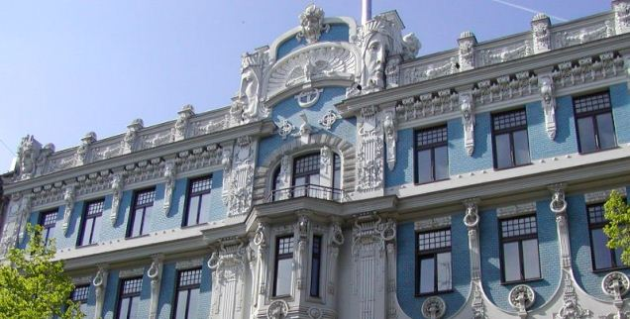
ART NOUVEAU
BUILDINGS IN RIGA
Riga is the metropolis of Art Nouveau. This style appeared in late 19th and early 20th century .
One third of the centre of Riga is built in Jugendstil or Art Nouveau style.

Slide 19
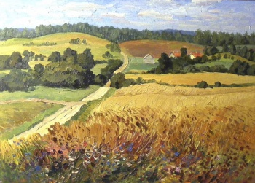
Painter Ansis Artums,
Latvians as peasants, mythology, pantheism, folk songs about 1 million
Ansis Artums. Ainava. Tukuma muzejs

Slide 20
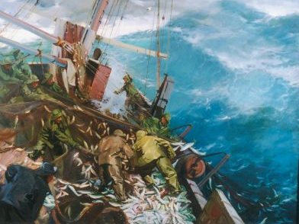

Slide 21
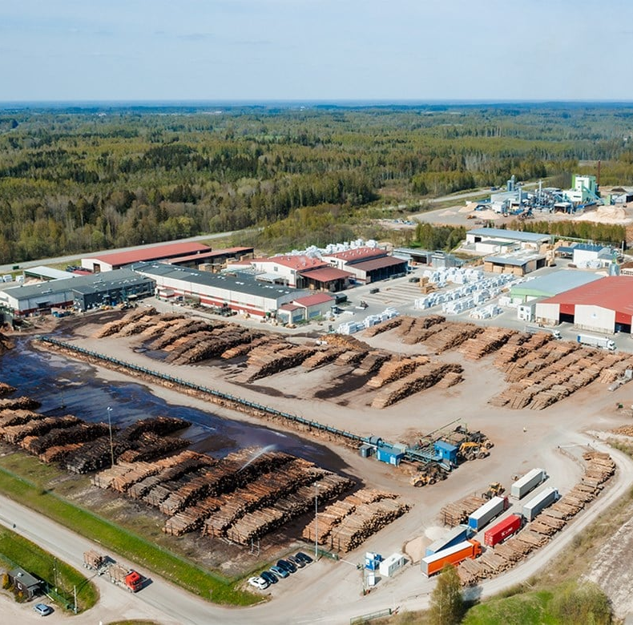
Main industries in Latvia
processed foods
processed wood products
textiles
processed metals
pharmaceuticals
railroad cars
synthetic fibers
electronics

Slide 22

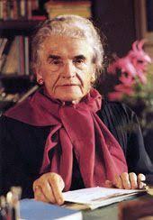
Latvijas rakstnieki domātāji
Latvian writers of the international range
Rainis
Aspazija
Zenta Mauriņa
Nora Ikstena
Cultural trends: hermeneutics, phenomenology, psychoanalysis, symbolism, Germa/Latvian romanticism, at the Soviet time- socialistic realism, marxism, after 1991- cultural capitalism, postmodernism

Slide 23
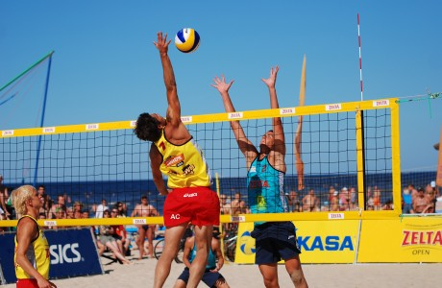
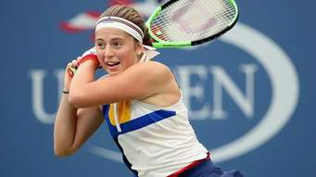
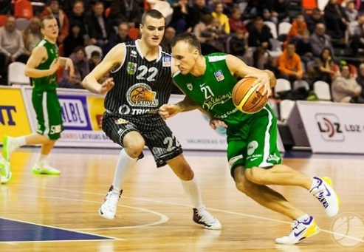
TENNIS
Jelena Ostapenko. Ostapenko has won nine WTA Tour-level singles and twelve doubles titles, including a singles major at the 2017 French Open and a doubles major at the 2024 US Open
BEACH VOLLEYBALL
Latvian beach volleyball team Tīna Gaudiņa and Anastasija Samoilova won a gold medals in the World Beach Volleyball Champion in Australia

Slide 24

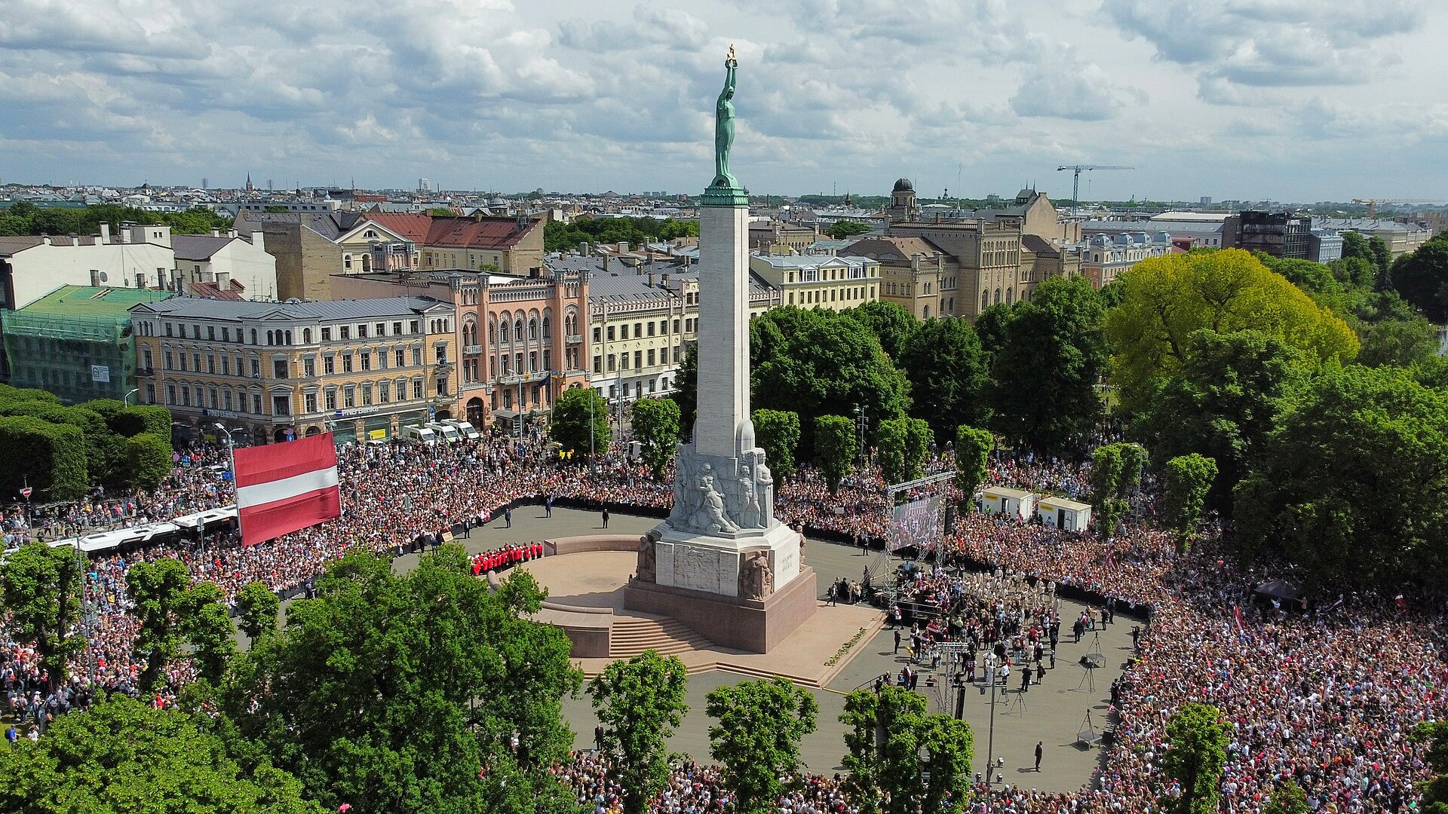

The Latvian national ice hockey team represents Latvia in international ice hockey competitions.
The team has participated in six Olympic Games — in 1936, 2002, 2006, 2010, 2014, and 2022.
The Latvian team’s greatest achievement at the World Championships was winning third place in 2023.
At present, the team is ranked 10th in the International Ice Hockey Federation (IIHF) rankings and will compete in the Elite Division of the World Championship in May 2026 in Switzerland.
The Latvian national ice hockey team ready for the WC in 2026
World Championship – 2023, 3.place, a nationwide celebration

Slide 25



Winter sports Milano-Cortina, 2026 : Latvia
the luge racer Elīna Ieva Bota won a silver medal at the Milan-Cortina Winter Olympic Games in February 2026
Short Track Speed Skating - Roberts Krūsbergs – bronze medal

Slide 26
ABOUT US and OUR ROTARY CLUBS

Slide 27




Latvian society and Rotary members have actively contributed to humanitarian assistance, particularly for Ukrainian children affected by the Russia-Ukraine war.
While countries have adopted different diplomatic approaches to the war in Ukraine, Latvia has taken a clear and principled position in support of Ukraine’s sovereignty and international law.
Beyond political statements, Latvian Rotary members have actively contributed to humanitarian assistance, particularly for Ukrainian society and children affected by the war. These actions reflect Rotary’s core values of service, compassion, and peace
- a charity concert «War Children» on 6 July 2015 Dzintaru concert hall.
Donated: 110 000 €
Latvian Rotary clubs within the charity received 4 Ukrainian groups of children

Slide 28

Guntars and Benita, SALASPILS ROTARY CLUB

Slide 29
Guntars Kniksts un Benita Kniksta
Guntars Kniksts
Salaspils RC, Governor
Rotarian since 2006, Club president 2008-2009, District RYLA coordinator in Latvia 2011-2016
Education – engineer, MBA degree
Occupation: Deputy Mayor of Garkalne County Council
Spending my free time playing in a rock band and enjoying live music
Benita Knikste
Education – Bachelor of Business Administration
Occupation – accountant in insurance company
Enjoy folk dancing and traditional Latvian sauna
Our family has 3 daughters

Slide 30
Guntars Kniksts - district 2410
Governor DG 2022/23

Slide 31

Guntars Kniksts, Rotary club meeting

Slide 32



MAIJA LINE
Rotary Club of Riga Ridzene
-Member of the Club since 1996 (charter member)
-President of the Club 2003-2004
-Board member 2005-2020
-D 2410 GSE co-ordinator in Latvia 1999-2009
-Assistant Governor 2008-2011
-D 2410 RFE Chairperson 2012-2026
-GSE team leader
to Australia 2006

Slide 33

MAIJA
Education – philologist, teacher, translator
Graduated from the University of Latvia, Department of English studies.
Occupation – now retired.
Last 21 year worked in the Ministry of Culture of Latvia
Family - have a daughter and a son, and five grandchildren.
Interests. Enjoy travelling, attending art and music events, walking on the
beach and picking wild berries and mushrooms in the forest.

Slide 34


ROTARY CLUB OF RIGA RIDZENE
Founded in 1996
Club during last decade has realised great number of charity projects
-Organized a social rehabilitation camp Angel Camp for children with untreatable diseases and families
-During Covid pandemic rendered support to doctors, who were fighting disease 24 hours.
-Help to Ukraine – started in 2015 with grand project War Children. Since 2022 Club helps by donating things for Ukrainean people, warm underwear for soldiers, things for babies in Kyiv Maturity hospital, etc.
-Help to disadvantaged street children – club donated for furnishing appartment, where they can find safe place.
-Support to Riga Active Senior association’s choir – donated
digital piano.
-Support to the young BMX team – donated shelter tent.
Riga Ridzene organized Rotary Summer Get-together 2025

Slide 35

Ludmila Jansone
RC Riga Ridzene
Rotarian since1997
GSE leader year 2010
President of Riga Ridzene Rotary
club, year 2010-2011
Project manager 2015-2026
Education-economy,finances
Retired

Slide 36

Rotary club of Riga Ridzene visiting Ventspils

Slide 37

Riga Rotary Club
Jānis Verlis is a member of Riga Rotary club, the oldest club in Latvia, founded in 1933, renewed in 1993, member of the club 18 years, was its president in 2012-2013.
Jānis is engaged in the timber business, has one daughter and one son, and six grandchildren.
Hobbies include swimming, opera, and theatre.

Slide 38





Riga Rotary club projects 2015-2026
Laza and equip special boarding school
Internat cabinets, kitchen tables and chairs, washing machine, 60 chairs Aula
The school's playground, 15 computers, 2 sewing machines, furniture
Ciblas school - school bags
Riga Disabled Society - Christmas gifts
Riga Children's Hospital
A charity concert «War Children»
Mobile lifting device for the nursing station Vegi

Slide 39

Dans Čiščakovs
Valmiera Rotary club

Slide 40

Valmiera Rotary club

Slide 41

Jānis Akerfelds Liepājas Rotary club

Slide 42

Jānis Akerfelds and Guna Akerfelde
Member of club since 2022
Wife Guna, 2 children son 12 years and daughter 9 years
Company owner – Modular house production– Module house export to 6 European countries.
Company since 2004.
Development – Real estate developer Hobies – beach tenis

Slide 43


Slide 44

Maija Kūle,
Riga Hansa Rotary club,
Rihards Kūlis
Philosophy, both are professors, University of Latvia, Maija is a Riga Hansa Rotary club member from 1996 and Paul Haris certificate of recognition and Paul Harris Fellow medallion.
2 sons Matiss and Maris, 6 grandchildren. Hobby – Maija: reading, writing philosophical essays, travel, Rihards: history of philosophy, music, gardening

Slide 45


Slide 46

Thank you for the attention!
Paldies par uzmanību!

